Slide 1
The Mushroom Chronicles Endangered Ecosystems - Why Plants (and People) Need Fungi
Maryland Sierra Club
William Needham
13 January 2021

Slide 2
Agenda
The Kingdoms of Life
Definition of Fungi and Key Attributes
Importance of Fungi in Health and Ecology
Morphology and Physiology
Endangered Fungi
Mycorrhizas
Ectomycorrhiza
Endomycorrhiza
Orchid mycorrhiza
Ericoid mycorrhiza
Monotropoid mycorrhiza
Summary and Conclusions

Slide 3
The Fungi
Pronunciation:
One fungus
Two fungi - fun j’eye
fun – guy
fun-gee
fun-jee
Definition:
Fungi are eukaryotic, heterotrophic, absorptive organisms that develop a rather diffuse, branched, tubular body and reproduce by means of spores.

Slide 4
What is a Fungus?

Slide 5
The Kingdoms of Life
The Two Divisions and Seven Kingdoms
Prokaryota Division (Lacking nucleus and mitochondria)
Archaebacteria or Archea
Eubacteria
Eukaryota Division (Specialization of prokaryotes in cell)
Plantae (produce food - photosynthesis)
Animalia (consume food - and fungi)
Fungi aka Eumycota (absorb food - decomposers)
Chromista* (“colored” – mostly unicellular and photosynthetic)
Protozoa* aka Monera (“first animals” – unicellular and mostly mobile)
* Frequently combined as the Kingdom Protista (“proto-life”)

Slide 6
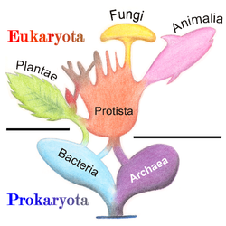
Eukaryotes and Prokaryotes
Prokaryotes – no nucleus
Bacteria – Blue-Green algae
Achaea
Eukaryotes - nucleus
Animalia – Primates to nematodes
Plantae – Green algae
Fungi – Mushrooms, molds, yeasts
Chromista – Brown algae, Slime molds
Protozoa - Amoebae
Protista

Slide 7
Heterotrophic (vs. Autotrophic)

Slide 8
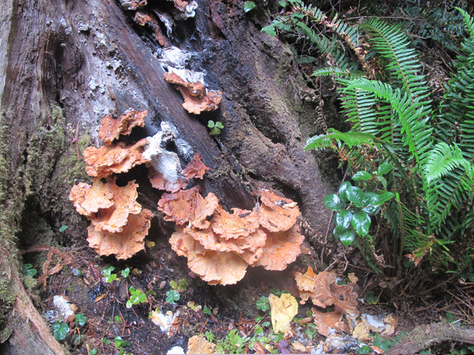
Absorption
Brown Rot Fungus - cellulase
Brown Rot

Slide 9
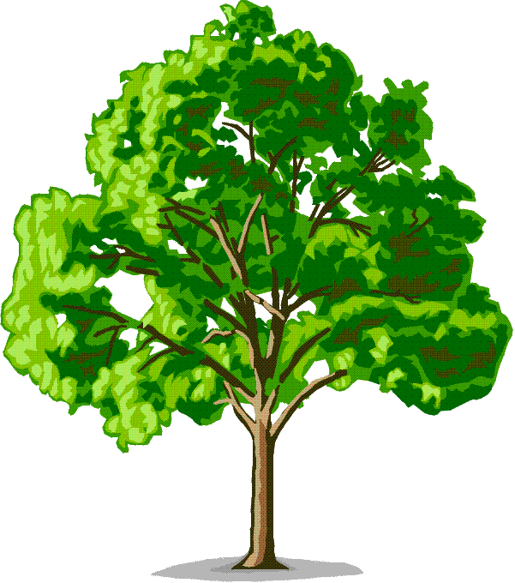
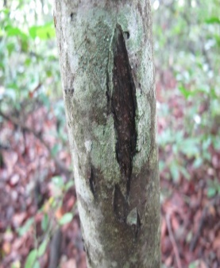
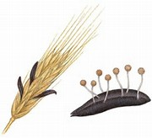
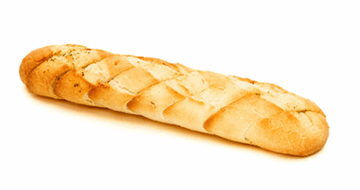
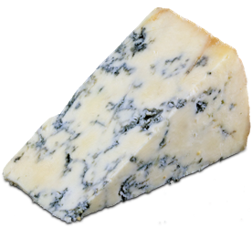
Importance of Fungi
Fungal diseases and infestations
Cryphonectria parasitica causes Chestnut blight (& bat white-nose death)
Claviceps purpurea causes ergotism
Rusts and Smuts (Wheat)
Fungi and culture
Bread, wine, and cheese with wild mushrooms Saccharomyces cerevisiae
Penicillium notatum and penicillin
Tolypocladium inflatum and Cyclosporin
Psilocybe mushrooms and LSD
Decomposition – enzymes and absorption
Two tons per hectare deposited annually
Saprophytic fungi (and some bacteria) decompose cellulose and lignin
Mycorrhizas – The foundation of the forest.

Slide 10
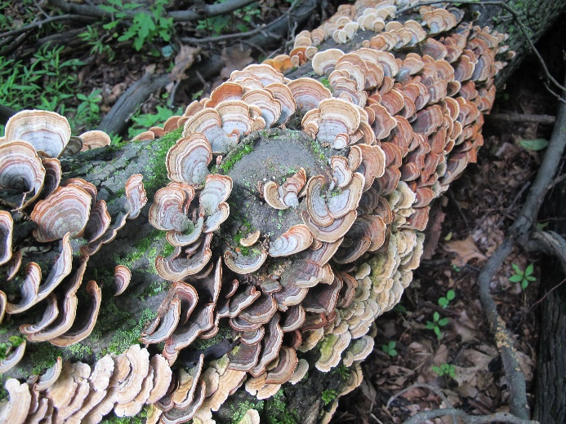
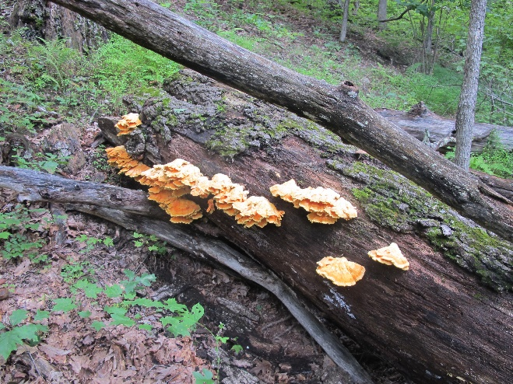
Decomposition
Cellulose is the most abundant polymer on earth
1.5 Trillion Tons Annually
Antarctic Iceberg 2017 - 1 Trillion Tons was
the size of Delaware
Sawdust is 50% cellulose, 25% lignin, 25% hemicellulose
Recycling lignocellulose materials mandatory to restore
carbon to the environment – CO₂ and H₂O make plants
Soil bacteria complete the process
1 billion bacteria in one gram of soil
1 ton (two cows) per acre
1 acre soil = 50,000 people
Fungi and Soil bacteria create 90% CO₂
Turkey Tail - Trametes versicolor
PLANTS PRODUCE AND FUNGI REDUCE
Chicken of the Woods
Laetiporus sulphureus

Slide 11
The Fungi
Kingdom Chromista (sometimes Protista)
Phylum Hyphochytriomycota – single front flagellum
Phylum Oomycota – front and rear flagella
Phytophthora infestans and Irish Potato Famine 1845-1847
Kingdom Fungi (sometimes Eumycota)
Phylum Chytridiomycota – single rear flagellum
Phylum Zygomycota – sexual reproduction by fusion
Class Zygomycetes Order Glomales -- Endomycorrhizas
Phylum Dikaryomycota - Ectomycorrhizas
Subphylum Ascomycotina – Cup Fungi
Subphylum Basidiomycotina - Mushrooms

Slide 12
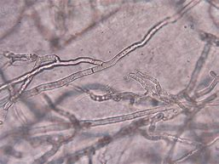
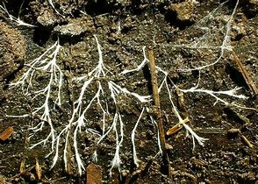
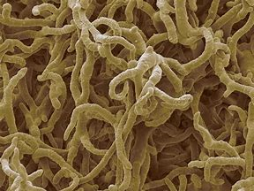
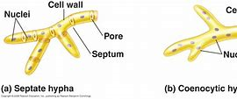
The Fungi Underground
Hypha - a filamentous tendril in fungi made of chitin
from the Greek hyphos, meaning web
grows in the assimilative mode.

Slide 13
The Real Fungus
Mycelium is the fungus; the Mushroom is the fruiting (spore producing) body
Mushrooms are created only when the fungus is ready to propagate, and the conditions are right – like after a rain.

Slide 14
Life cycle of Mushrooms

Slide 15
Endangered Fungi
IUCN Red List 2021 contains 436 species
None listed as extinct
6% (26) Critically Endangered, 19 % Endangered
Mostly due to human impact in temperate forests
Primarily Lichens
Loxospora assateaguensis – Virginia shoreline
Hypotrachyna virginica – Appalachian mountains
Sulcaria isidiifera – California shore
One mushroom - Yellow-gilled Lepiota

Slide 16
Endangerment and Fungi
IUCN and Fungi listings
2019 – 280 (15 Critically Endangered)
2017 – 56
2014 – 5
4 Lichens Cladonia perforata, the Florida Perforate Reindeer Lichen
1 Mushroom Pleurotus nebrodensis, the White Ferula Mushroom (Sicily)
Fungi and Population assessments
1.5 to 5 million species of fungi
Fungi are mostly hypogeal and only appear as fruiting bodies
Variability of fungal sporulation (the masting behavior of mushrooms)
Lichens are epigeal in exposed areas for access to sunlight for algal photobiont
In North America, there is almost no records of historical fungal populations
“How can you tell when a particular microscopic fungus, which can only be detected by culturing the soil, or a macroscopic fungus that may fruit only once in 20 years, has finally succumbed?” Bryce Kendrick in Fifth Kingdom

Slide 17
Intergovernmental Science-Policy Platform on Biodiversity and Ecosystem Services (IPBES)
Up to 1 million: species threatened with extinction, many within decades
8 million total estimated number of animal and plant species on Earth (including 5.5 million insect species)
>40% amphibian species threatened with extinction
At least 680 vertebrate species driven to extinction by human actions since the 16th century
Three-quarters of the land-based environment and about 66% of the marine environment have been significantly altered by human actions
Since 1970 the global population has more than doubled from 3.7 to 7.6 billion
More than a third of the world’s land surface and nearly 75% of freshwater resources are now devoted to crop or livestock production.
68%: global forest area today compared with the estimated pre-industrial level
>2 billion: people who rely on wood fuel to meet their primary energy needs
70%: increase since 1970 in numbers of invasive alien species across 21 countries with detailed records

Slide 18
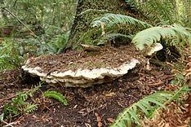
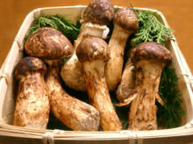
Ecosystem of Fungi and Plants
Bridgeporus nobilissimus – Noble Polypore
Perennial, imbricate, sessile fruit bodies that measure 12–55 inches in old growth forests of Pacific Northwest.
B. nobilissimus was listed in 1995 as an endangered species by the Oregon Natural Heritage Program, making it the first of the fungi to be listed as endangered by any private or public agency in the United States.
There were 13 known sites with the fungus before 1998; extensive surveying in the Pacific Northwest increased this number to 103 sites by 2006
Matusake
Tricholoma matsutake, T. nauseosum, Armillaria ponderosa
Closely associated with Pinus densiflora, also called the Japanese red pine
In Japan it is known as akamatsu (赤松, literally "red pine")
Notes:
‹#›

Slide 19
Definition of Mycorrhiza
Mykes - Greek word for fungus
Fungus is from spongos, the Greek word for sponge
The spongy surfaces of some fungi suggest a relationship
Mushroom is from moisseron which is in turn derived from mousse, the French word for moss.
The English took it as a calque word; moisseron = mushroom
Toad Stool is from German todesstuhl, “death chair.”
Rhizon - Greek word for root
Mycorrhiza is “Fungus – Root”

Slide 20
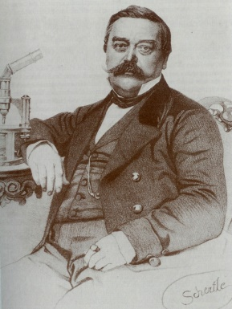
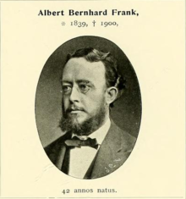
Historical
First noted in an 1840 paper by Theodor Hartig, a German forestry scientist
Described and illustrated the mantle inside the root
Attributed to the root and not to external fungi
Albert Frank, German botanist, plant pathologist, and mycologist coined the term mycorrhiza
Practical methods for truffle cultivation by the King of Prussia
1885 paper "Ueber die auf Wurzelsymbiose beruhende Ernährung gewisser Bäume durch unterirdische Pilze“
Opposed by the scienfic community until early 20th
Century when the evidence was overwhelming

Slide 21
Macro-Mycorrhiza
Photobiont
Root
Mycorrhiza
Mycobiont

Slide 22
Micro-Mycorrhiza
Root
Mycorrhizal
Hypha

Slide 23
Evolution and History
Devonian land plants evolved from sea plants
Photosynthesis from chlorophyll
No root structure - not needed in aqueous environment
In search of water and minerals
Fungi preceded plants on land
Fungi evolved filaments called hyphae to penetrate soil
Shortage of sources of carbon for energy
Fungi and Plants evolved together due to the mutualistic symbiosis
Plants get water and minerals, fungi get energy
Devonian fossil plants have fungi in their roots
Lichens may have been the first (600mya)

Slide 24
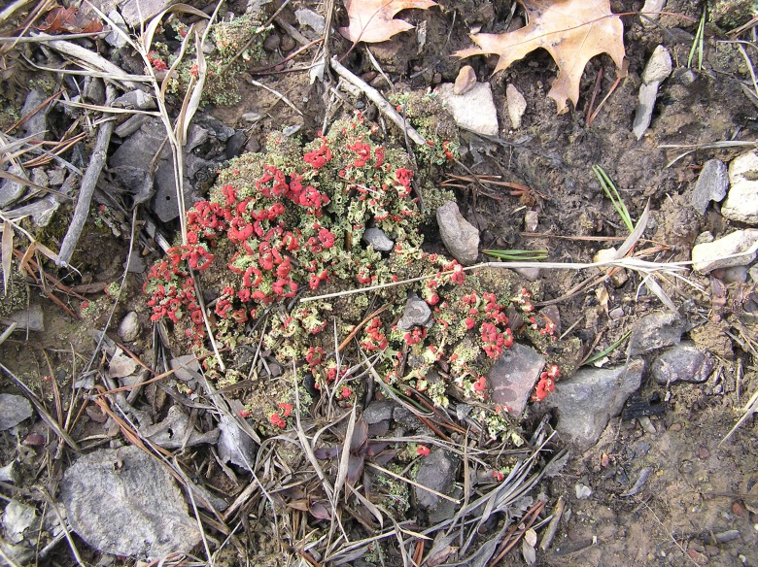
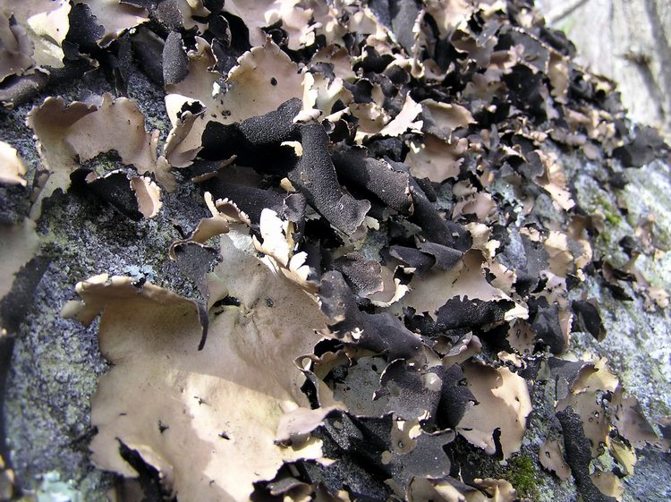
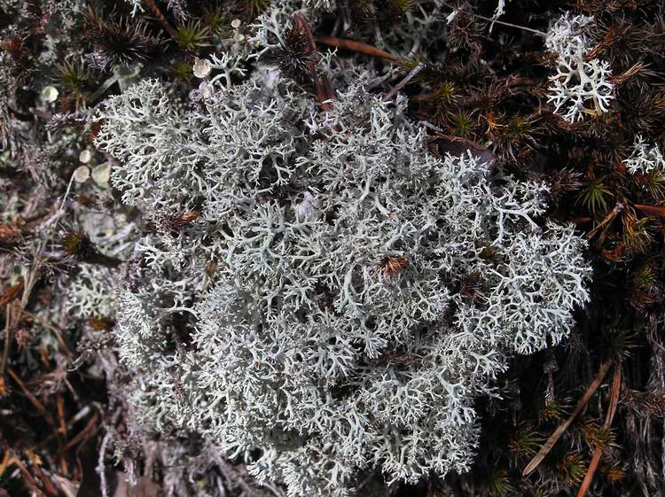
Lichens
Rock Greenshield Lichen
British Soldier Lichen
Rock Tripe
Reindeer “Moss”
Notes:
‹#›

Slide 25
Importance of Mycorrhizas
90 percent of all healthy plants have mycorrhiza
“The establishment and growth of most plants requires, or is enhanced by, the presence of specialized fungi” Carlile et al in The Fungi.
“Some plants cannot become established or grow normally without an appropriate fungal partner” Bryce Kendrick in The Fifth Kingdom.
The plants that don’t need fungi for growth have well developed and rapid growth root systems
Opportunistic and able to occupy disturbed areas
Weeds and some grasses and sedges
The plants that are obligate to (must have) fungi are all pine family trees and most other trees
From an evolutionary standpoint this makes sense
Trees put the most demand on their root systems.

Slide 26
Importance of Mycorrhizas
Trays of sterilized soil with 1,2,4,8 or 14 different mycorrhizal species sown with 100 seeds from a mixture of 15 different plants
Phosphorous
Soil
Plant
ATP 🡪 ADP
The Fungi
p. 398

Slide 27
Importance of Mycorrhizas Plant Types associated with mycorrhizal fungi
Ectomycorrhizal Fungi | Endomycorrhizal Fungi
2,000 Species, mostly trees | 300,000 Species, Excluding!!!
All Pine Family (Pines, Firs, | Brassicaceae - Cabbage, turnip
Spruces, Hemlocks, Douglas Fir) | mustard, cauliflower.
 | Commelinaceae - Spiderworts
All Beech Family (Oak, Beech) | Cyperaceae - Sedges
 | Juncaceae - tufted grassy herbs
All Birch Family (Birch, Alder) | Trees (they are ectomycorrhizal)
Some Maple, Rose, Elm Family | Some other weeds

Slide 28
Importance of Mycorrhizas
Mutualistic symbiosis (both organisms benefit)
The mycobiont gets hexose from the phytobiont
Not normal, induced by fungal enzymes
Converted by fungus to glycogen for storage which comprises about 10% of dry weight
Additional storage in the disaccharide trehalose and polyhydric alcohols (polyols) which comprise an additional 15% of dry weight
The phytobiont gets minerals and water from the mycobiont
Phosphorous for the production of energy (ATP 🡪 ADP)
Nitrogen for nucleic acids and chitin, the primary fungal cell wall material (as opposed to cellulose for plants)
Reserve reservoir of nutrients (a mycobiont can provide enough reserve phosphorous to a tree for 10 days)
The key to the relationship for trees is reserve energy storage and distribution
“wood wide web”

Slide 29
The Wood Wide Web
Peter Wohlleben The Hidden Life of Trees
“A tree’s most important means of staying connected to other trees is the ‘wood wide web’ of soil fungi that connects vegetation in an intimate network that shares an enormous amount of information and goods”
Dr. Suzanne Simard et al “Net Transfer of Carbon between tree species with shared Ectomycorrhizal Fungi” Nature 1997
“When the interwoven birches and firs were spiked with stable and radioactive isotopes, I could see, using mass spectrometers and scintillation counters, carbon being transmitted back and forth between the trees, like neurotransmitters firing in their own neural networks. The trees were communicating through the web!!!”
20 years later it is clear now that the forest is a macro-organism

Slide 30
Mycorrhizal Connections
Trees
Mycorrhizal
Connections

Slide 31
Wood Wide Web
Ploughing up the wood-wide web? Nature 394, 431 (30 July 1998)
T. Helgason1, T. J. Daniell1, R. Husband1, A. H. Fitter1 & J. P. W. Young1
Key species groups that affect major ecological processes are vital components of community diversity. Many such key groups are found in the soil, including the mycorrhizal fungi that may connect plants into a functional "wood-wide web“
Arbuscular mycorrhizal associations are formed by fungi of the order Glomales with 90% of land plant families, and many arbuscular mycorrhizal fungi are thought to have a broad host range
Here we show that, despite this broad host range, the diversity of arbuscular mycorrhizal fungi is strikingly low in arable sites compared with a woodland.

Slide 32
The Hidden Life of Trees Peter Wohlleben 2015
“The wood wide web has been mapped, traced, monitored and coaxed to reveal the beautiful structures and finely adapted languages of the forest network. We have learned that mother trees recognize and talk with their kin, shaping future generations. In addition, injured trees pass their legacies on to their neighbors, affecting gene regulation, defense chemistry, and resilience in the forest community. These discoveries have transformed our understanding of trees from competitive crusaders of the self to members of a connected, relating, communicating system.”
- Dr. S. Simard, Prof. Forest Ecology, UBC
Sons of beeches – Gary Lincoff
Masting behavior of trees

Slide 33
The Hidden Life of Forests
Work in this area has steadily advanced to the forest scale
A canopy crane was used to mark Norway spruce trees with carbon dioxide using the isotope carbon 13 (vice the normal carbon 12 with 6 protons and 6 neutrons)
At the end of the five-year study period, 40 percent of the fine root carbon in adjacent beech, larch and pine trees was isotopic and can only have come from the spruce trees
Klein, T. et al “Belowground carbon trade among tall trees in a temperate forest.” Science 15 April 2016, Vol. 352, Issue 6283, pp. 342-344.

Slide 34
The Forest Unseen

Slide 35
Types of Mycorrhizas
Ectomycorrhiza – Fungus outside root
Endomycorrhiza – Fungus inside root
Orchidaceous – Orchids
Ericaceous – Ericaceae
Heathers, Rhododendrons (Rosebay and Azalea)
Monotropoid – Monotropa
Indian pipe or Ghost pipe and Pinesap

Slide 36
Ectomycorrhizal Morphology
Develop 1 – 3 months after germination
Roots colonized by hyphae from another mycorrhizal root or from surface spores
Process of colonization
Penetration of hyphae to form Hartig Net
Mantle of hyphae outside root
Extension of hyphae into soil
Fungus produces plant growth hormones
Short roots grow faster
Roots thicken
Roots form branches

Slide 37
Ectomycorrhizal Morphology
Fungal plant growth hormones promote root tips to grow faster and
thicker and to branch out (dichotomy in Pinus species)

Slide 38
Ectomycorrhizal Morphology
The Hartig net protects cortical (root) cells and prolongs life and
suppresses the growth of root hairs which are now redundant

Slide 39
Ectomycorrhizal Morphology
Ectomycorrhizal roots are a different color, more branched and thicker than normal roots

Slide 40
Ectomycorrhizal Fungi
Most of the ectomycorrhizas are similar, distinguished only by the fruiting body (the mushroom)
Most are basidiomycetes (73 genera and 9 orders)
Almost all of the following families
Boletaceae
Russulaceae
Stobilomycetaceae
Cantharellaceae
Most of the following genera
Amanita
Cortinarius
Hebeloma
Laccaria
Scleroderma
Tricholoma
Some have a wide range of hosts. Others are selective to specific trees

Slide 41
Ectomycorrhizal Fungi
Amanita muscaria
Cantharellus cibarius
Boletus bicolor
Russula spp

Slide 42
Ectomycorrhizal Plants
Gymnosperms
All Pinaceae
Some Cupressaceae
Angiosperms
All Fagaceae (Beech), Betulaceae (Birch), Salicaceae (Willow)
Most Myrtaceae
Many Legumes

Slide 43
Ectomycorrhizal Plants
White Pine – Pinus strobus
Virginia Pine – Pinus virginiana
Hawksbill
Limberlost
Eastern Hemlock – Tsuga canadensis
Balsam Fir – Abies balsamea

Slide 44
Ectomycorrhizal Plants
White Oak – Quercus alba
Northern Red Oak – Quercus rubra
Yellow Birch – Betula alleghaniensis
American Beech – Fagus grandifolia

Slide 45
Endomycorrhizal Morphology Vesicular-Arbuscular Mycorrhizas (VAM)
Usually not visible to naked eye
Lifecycle
Spores germinate
Fungal hyphae extend to root
Appressorium to penetrate root
Hyphae enter cortical cells
Arbuscules
Enclosed in the cortical cell
Sites for transfer of minerals
Breaks down in 4 – 15 days
Vesicles not always present
Thin walled storage structures
Store lipids
Extramatrical hyphae
Link to other VAM hyphae

Slide 46
Endomycorrhizal Morphology
Arbuscule – “Little Tree” – A finely branched organ produced by endomycorrhizal fungi inside host plant cells; the interface at which fungus and plant exchange phosphorus and photosynthates

Slide 47
Endomycorrhizal Fungi
Vesicle – Swollen lipid-filled cells produced inside plant roots by most endomycorrhizal fungi (sometimes called intramatrical spores)

Slide 48
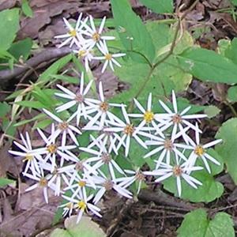
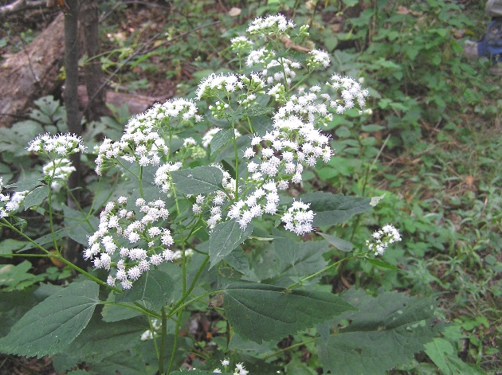
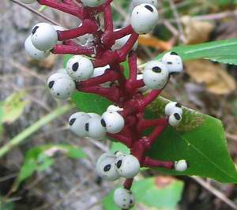
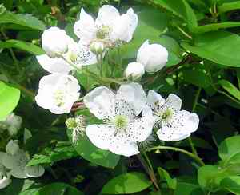
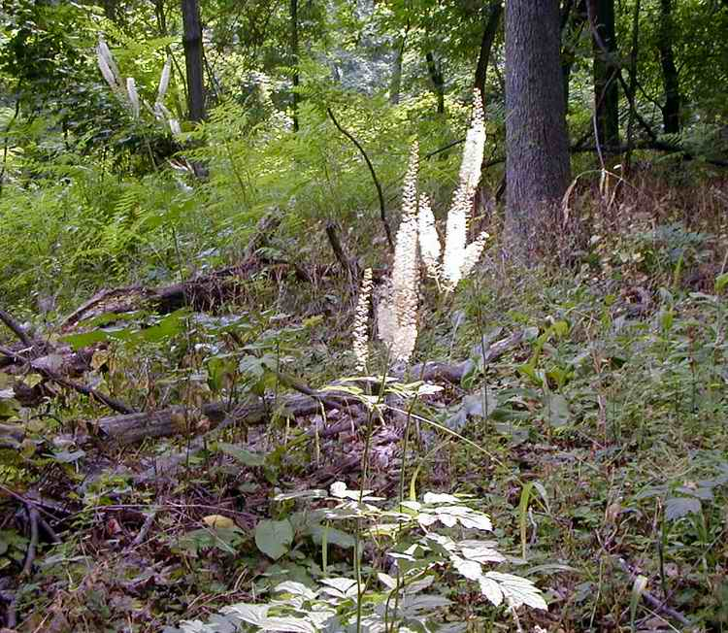
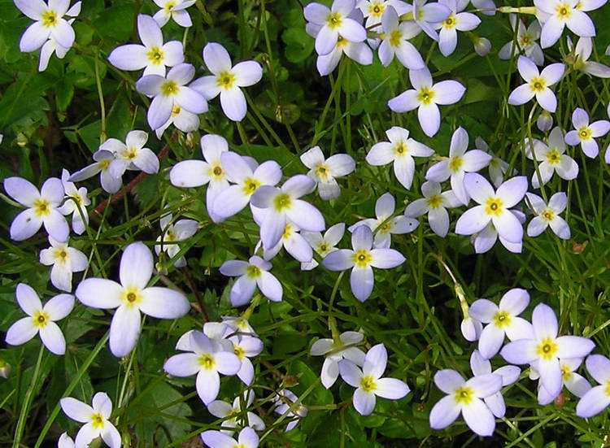
Endomycorrhizal Plants
White Wood Aster
White Snakeroot
The weed that killed Lincoln’s mother
White Baneberry
Doll’s Eyes
Bluets
Quaker Ladies
Blackberry
Black Cohosh

Slide 49
Other Mycorrhizas
Ectomycorrhiza
Hartig Net
Endomycorrhiza
Intracellular vesicles
Branched arbuscules
Orchid mycorrhiza
Intracellular hyphae
Pelotons (coils) formed
Digested by cell
Ericaceous mycorrhiza
Bundles of hyphae in
cells connected to roots

Slide 50
Orchidaceous Mycorrhizas Mycoheterotropic – Plants that form associations with fungi which supply them with carbon compounds
Orchid seeds contain almost no food for germination; they produce thousands of tiny seeds – reliant on fungi for food
Orchids comprise tens of thousands of species so this must be a successful partnership, though not totally mutualistic
Orchidaceous mycobionts commonly from Rhizoctonia a genus of anamorphic fungi in the order Cantharellales.
Fungi are saprobes, they provide the carbon from insoluble materials in the soil or from other plants
Particularly important to the orchid in the seed stage
Insufficient food reserves for seedling development (2-11yrs)
Fungus penetrates into nascent roots and is digested by the cell
Some mature orchids live without photosynthesis.

Slide 51
Orchidaceous Mycorrhizas
Showy Orchis – Orchis spectabilis
Rattlesnake Plantain –Goodyera pubescens
Yellow-Fringed Orchid – Habenaria ciliaris
Pink Lady’s Slipper

Slide 52
Ericoid Mycorrhizas
The ability of Heath Family trees and shrubs to occupy marginal habitats with depleted resources.
Intermediate between endomycorrhizas and ectomycorrhizas
Formerly known as “ectoendomycorrhizas”
Roots have a sheathing layer with branches much like the ectomycorrhizas
Rather than a Hartig Net, the hyphae penetrate the cortical cells and form coils that are not arbuscular
Some fungi can form multiple relationships
Ectomycorrhizal with Pine Trees
Ericoid mycorrhizal with Heath Family Trees

Slide 53
Ericoid Mycorrhizas
Mountain Laurel
Rhododendron and Azalea

Slide 54
Monotropoid Mycorrhizas
Perhaps the most peculiar of all, plants that use fungi that use plants
Tripartite relationship
Mycobiont provides nutrients to the monotropid and to the phytobiont
Phytobiont provides nutrients to the fungus
The monotropid is essentially a parasite (and not a saprophyte)
Monotropid is achlorophyllus
Produces roots which have a fungal mantle
The root cell is penetrated by a peg-like structure.

Slide 55
Monotropoid Mycorrhizas
Pinesap – False Beech Drops
Monotropa hypopitys
Indian Pipe Monotropa uniflora

Slide 56
Current Research
Science Magazine 13 January 2017
“Belowground Drivers of Plant Diversity” – Wim H. van der Putten
Fewer offspring are recruited under the parent arbuscular mycorrhizal trees than when the trees are ectomycorrhizal. Arbuscular mycorrhizal trees promote forest diversity.
Ectomycorrhizal fungi enhance plant performance.
Plants with more mycorrhizal colonization had fewer lesions and grew better
Arbuscular mycorrhizal trees had more root lesions than ectomycorrhizal trees.
“In the soil symphony orchestra, arbuscular mycorrhizal fungi may thus play the first violin”

Slide 57
Summary
Fungi are fundamental to the health of natural ecosystems
The network that permeates the forest subsurface sustains the trees by sharing and storing resources.
Mycorrhizas are critical to the survival of both fungi and trees
A better understanding of mycorrhizas would yield significant dividends to
Reforestation for natural and commercial purposes
Growth of plants for food
Combat climate change
Notes:
‹#›

Slide 58
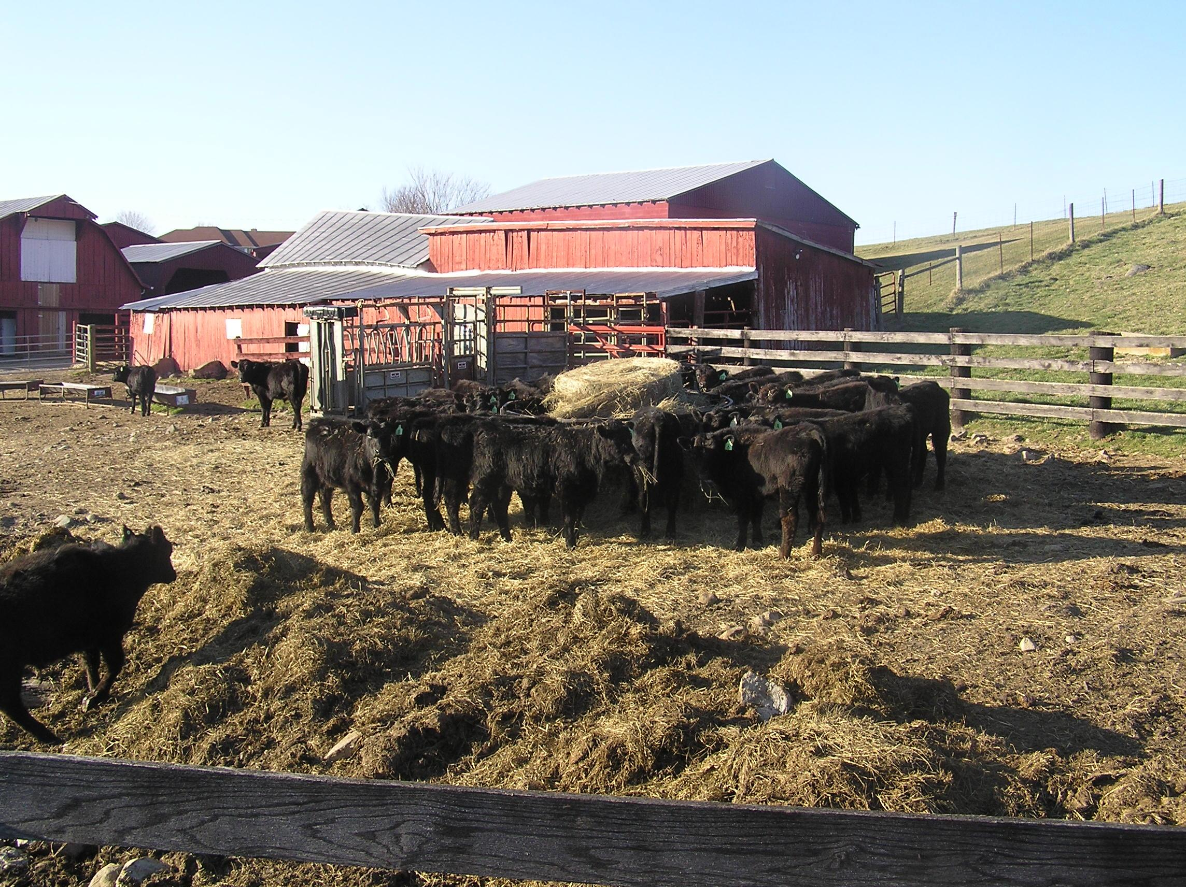
The Wizard and the Prophet
+/-25%: greenhouse gas emissions caused by land
clearing, crop production and fertilization,
with animal-based food contributing 75% to that figure
Mycoremediation
Notes:
‹#›

Slide 59
The Kingdom Fungi
A key part of nature’s ecosystems
Decomposition of plant matter
Growth of forests through mycorrhizas
Source of food and medicine
Future
Expanded non-meat protein source (Quorn)
Eat more Chicken of the Woods and Beefsteak Fungus
Decomposition for industrial use (paper mills)
Medicinal products (drug resistance).
Restoration of wastelands

Slide 60
Mycological Association of Washington (MAWDC)
The Mycological Association of Washington, DC (MAW) is a nonprofit club of amateur and professional mycologists. We study, forage, and cook wild mushrooms, and educate the public about fungi. Our events in DC, Maryland, and Virginia include monthly guest speakers, forays with expert identifiers, and members-only tasting events.
To learn more about the hidden, magical world of mycelium beneath your feet, and find out which mushrooms grow in your neck of the woods, join us for an upcoming meeting or foray.
If you'd like to be a member, and join other like minded mycophiles, please see our join us page. Its an easy online process. Outstanding questions or concerns about membership can be directed to membership@mawdc.org.
MAW membership entitles you to:
Participate in local MAW forays, including special members-only forays.
Participate in our annual fungi tasting dinners.
Receive our newsletter, Potomac Sporophore, published several times a year.
Join the North American Mycological Association at a reduced rate.
Annual dues are $20.00 for individual membership or $30.00 for a household. Your contribution helps support programming and club operations, including bringing in engaging speakers for our monthly meetings.

Slide 61
References
Audubon Guide to North American Mushrooms – Gary Lincoff
The Fifth Kingdom – Bryce Kendrick
Mushrooms of West Virginia and the Central Appalachians – William Roody
www.mushroomexpert.com – Michael Kuo
For fungus identification
www.hikersnotebook.blog – William Needham
For “ethnomycology” – and flora, fauna, and geology

Slide 62
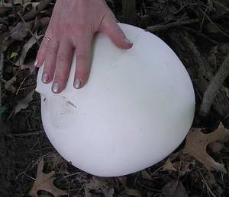
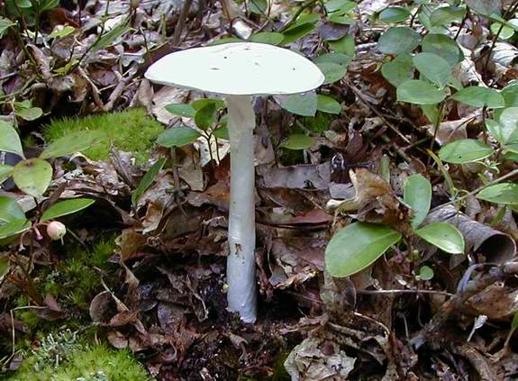
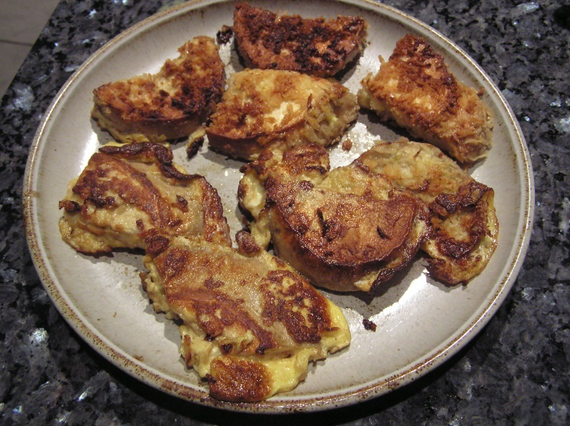
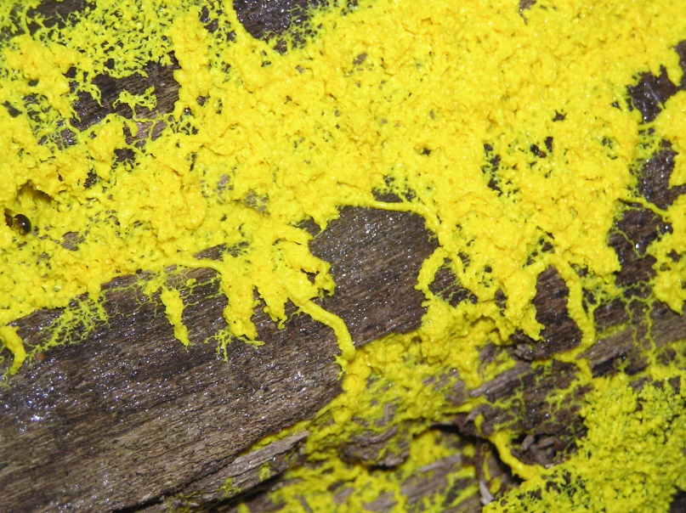
Questions or Comments

