Slide 1
Governor’s Executive Order 80 and The Green New Deal Gerry Kingsley CPG Chairperson

Slide 2
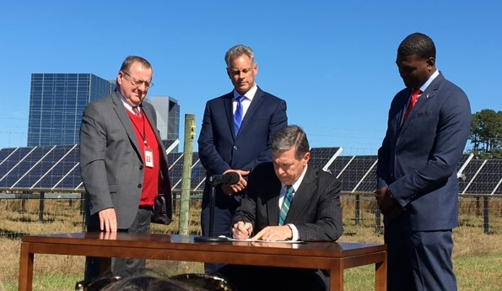
Executive Order 80 – Sierra Club Statement
"The Sierra Club calls on business and nonprofit leaders, local and state elected officials, and Duke Energy to join the Cooper administration in this far-sighted effort to ensure that North Carolina does its part to combat global climate change."
"We must act now to address climate change for the sake of our society and for future generations. North Carolina is at particular risk, as recent hurricanes Matthew, Florence and Michael illustrate. We must do better to protect our communities and the natural environment from more extreme storms, sea-level rise and other impacts of climate change. Gov. Cooper's order shows that his administration is serious about tackling the threat climate change poses to our state. We look forward to participating in the stakeholder process."

Slide 3
Goals of Executive Order 80
North Carolina will support these 2015 Paris Agreement goals by 2025
Reduce energy consumption per square foot by at least 40 percent from 2002-2003 levels in state owned buildings
Reduce statewide greenhouse gas emissions to 40 percent below 2005 levels
Increase the number of registered zero emission vehicles to at least 80,000

Slide 4
Executive Order 80 – Council and Plans
EO 80 establishes a North Carolina Climate Change Interagency Council, chaired by the Secretary of the Department of Environmental Quality (DEQ)
A Clean Energy Plan must be developed, along with the following sub-plans, by October 1, 2019
North Carolina Clean Energy Plan – NC DEQ
North Carolina Zero Emission Vehicle Plan – NC DOT
Workforce assessments and recommend actions to meet our workforce needs – NC Department of Commerce
North Carolina Motor Fleet ZEV plan – NC Department of Administration
Comprehensive Energy, Water, and Utility Use Conservation Program to reduce energy consumption in state buildings – NC DEQ

Slide 5
DEQ’s Clean Energy Plan Development Process
Method 1: Facilitated Workshops
Method 2: Regional Listening Sessions
Method 3: Combined with Other Statewide Events
Method 4: Online Input
Jan Feb Mar Apr May Jun Jul Aug Sep
Strategy and Planning
Workshops and Listening Sessions
Draft Plan Development
Public Comment on Draft Plan
Revised Plan Reviewed and Approved

Slide 6
Executive Order 80 Upcoming Events
March 29 Hickory Listening Session
April 1 Clean Energy Plan Workshop 2
April 11 Elizabeth City Listening Session
April 22 Clean Energy Plan Workshop 3
April 26 NC Climate Change Interagency Council
May 7 Wilmington Listening Session
May 14 Charlotte Listening Session
May 17 Greensboro Listening Session
May 22 Clean Energy Plan Workshop 4
June 5 Asheville Listening Session
June 18 Greenville Listening Session
June 26 Clean Energy Plan Workshop 5
July 24 Clean Energy Plan Workshop 6

Slide 7
The Green New Deal

Slide 8
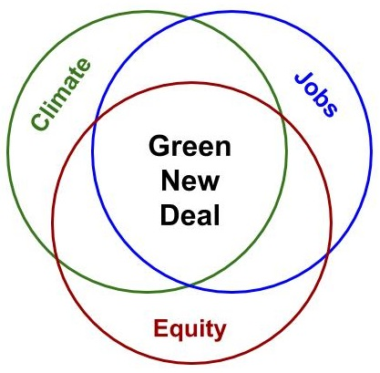
Green New Deal
The Green New Deal is a massive economic stimulus with 3 essential pillars. There's a wide swath of popular policy ideas that would achieve all three pillars at once.
Tackling the climate crisis and toxic pollution
Creating good, high-paying jobs
Fighting racial, economic, and gender inequity

Slide 9
What is a Green New Deal?
A Green New Deal is a big, bold transformation of the economy to tackle the twin crises of inequality and climate change. It would mobilize vast public resources to help us transition from an economy built on exploitation and fossil fuels to one driven by dignified work and clean energy.
The status quo economy leaves millions behind. While padding the pockets of corporate polluters and billionaires, it exposes working class families, communities of color, and others to stagnant wages, toxic pollution, and dead-end jobs.
Climate change and inequality are inextricably linked. We cannot tackle one without addressing the other. A Green New Deal would take on both.

Slide 10
The Green New Deal
The GND is an aspirational non-binding resolution that acknowledges severe climate issues, the disproportionate US role in creating climate change, and the impact on vulnerable classes of people
The US has historically been responsible for a disproportionate amount of greenhouse gas emissions
Climate change has exacerbated systemic social injustices
Climate change constitutes a direct threat to the national security of the US
The federal government led mobilizations during WWII and the New Deal that created a great middle class, but many members of frontline and vulnerable communities were excluded from the benefits of those mobilizations

Slide 11
What would a Green New Deal achieve?
Millions of family-sustaining jobs
Clean air and water
Community resilience
Climate Sanity
Lower costs
Greater racial and economic equity

Slide 12
Criticisms of The Green New Deal
The “Green New Deal is a recipe for mass suicide”, and “Americans could be forced to turn to cannibalism.” – Patrick Moore, Greenpeace Co-Founder
“This isn’t just radical socialism, this is madness” – Anthony Watts, wattsupwiththat.com
“The radical plan would replace fossil fuels by building hundreds … of costly new renewable energy facilities across the country.” – Justin Haskins, Fox News
“It would mean the end of ice cream, hamburgers, and the US military.” – US Senator John Barrasso, US Senator Marsha Blackburn, US Congresswoman Liz Cheney
“Ridiculous” and that the true solution to climate change is to “fall in love, get married, and have some kids.” – US Senator Mike Lee
“I think it is very important for the Democrats to press forward with their Green New Deal. It would be great for the so-called “Carbon Footprint” to permanently eliminate all Planes, Cars, Cows, Oil, Gas & the Military … Brilliant!” – US President Donald Trump

Slide 13
Additional Resources
Sierra Club
https://www.sierraclub.org/trade/green-new-deal
National Geographic
https://www.nationalgeographic.com/environment/2019/02/3-steps-green-new-deal-must-pass-to-work/
New York Times
https://www.nytimes.com/2019/02/14/opinion/green-new-deal-ocasio-cortez-.html

Slide 14
Call to Action
Treat everyone with love, kindness, and respect
Participate in Resolution 80 via DEQ sessions
Participate in the political process
Vote
Call / write / email your government representatives

