Slide 1
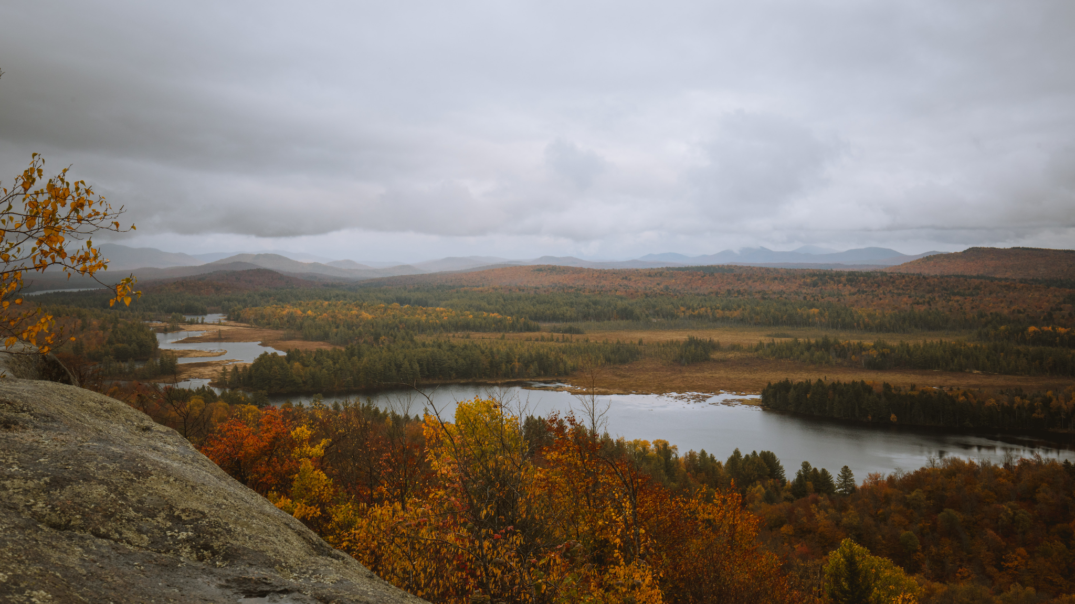
Return of the Wolf to the Northeast?
Renee Seacor
Carnivore Conservation Director
Project Coyote

Slide 2
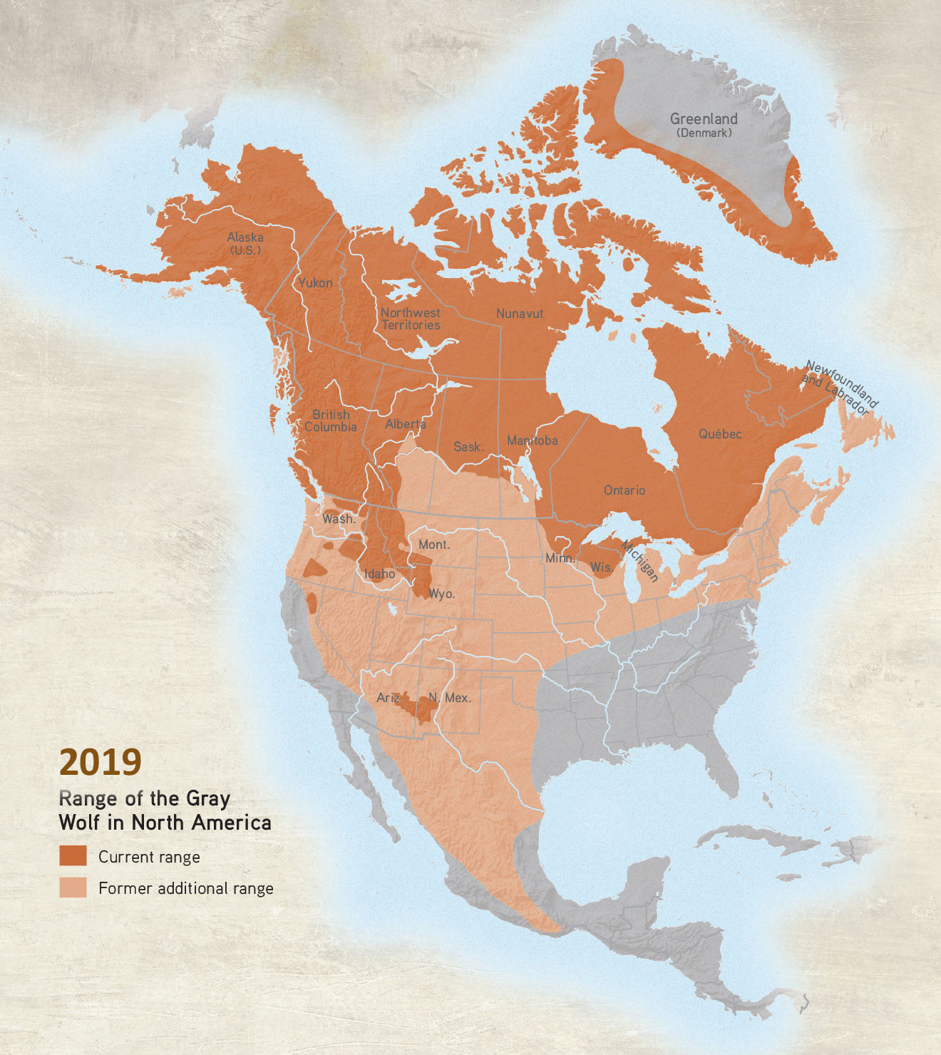
The Colonial War on Wolves
historic range: most of North America
19th and 20th centuries, wolves and wild carnivores faced “predator extermination campaigns” through the middle of the last century
the reasons?
european worldviews
perceived threats to farmed animals
perceived threats to wild ungulate species
Credit: Living with Wolves

Slide 3
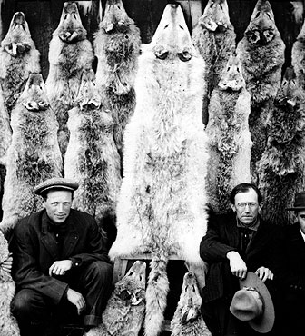
The Colonial War on Wolves
fears & misconceptions led to both federal and state governments issuing bounties to incentivize wolf killing
This led to the eradication of almost all wolves from the lower 48 by the 1930s
Credit: PBS
Credit: PBS Nature

Slide 4
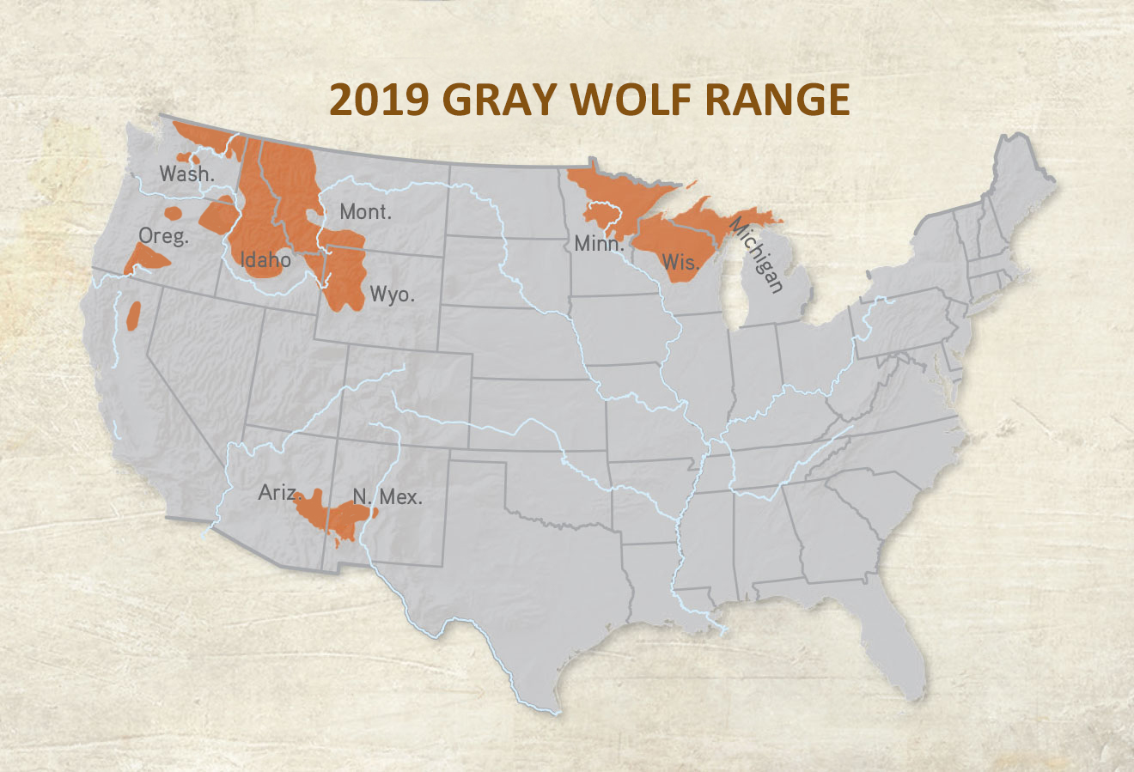
Recovery timeline
Credit: Living with Wolves
Endangered Species Act Signed into Law
Wolves listed as endangered across the lower 48.
Relentless attempts at delisting
U.S. Fish and Wildlife Service attempts to delist wolves both regionally and nationally
1990s
2021-22
1974
2000s
Reintroduced into Northern Rockies
U.S. Fish and Wildlife Service reintroduced wolves into Yellowstone and Idaho. Mexican gray wolves introduced in Arizona and New Mexico (1998). Red Wolves in South Carolina starting in 1987.
Wolves delisted and then overturned in 2022.

Slide 5
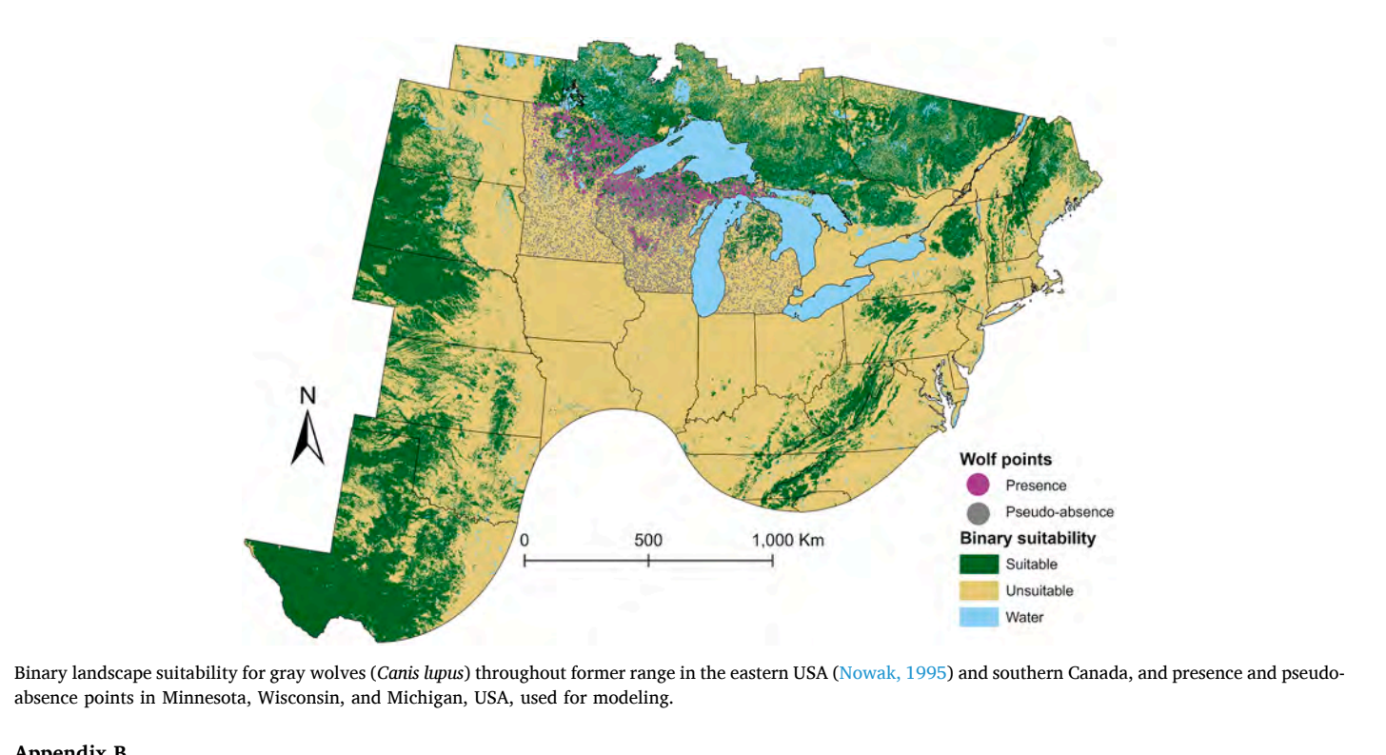
Models of Wolf Habitat in the Northeast
Credit: van den Bosch et al. 2022

Slide 6
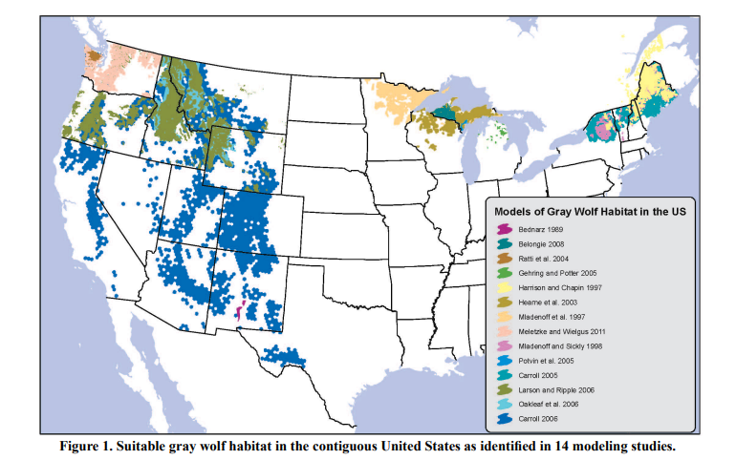
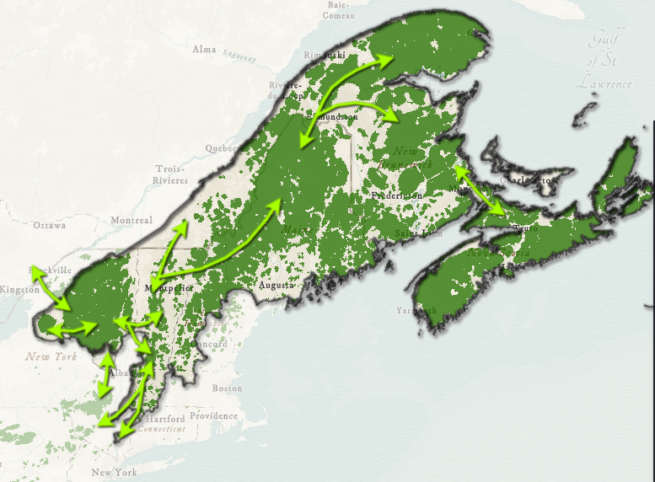
Models of Wolf Habitat in the Northeast
Image Credit: Center for Biological Diversity

Slide 7
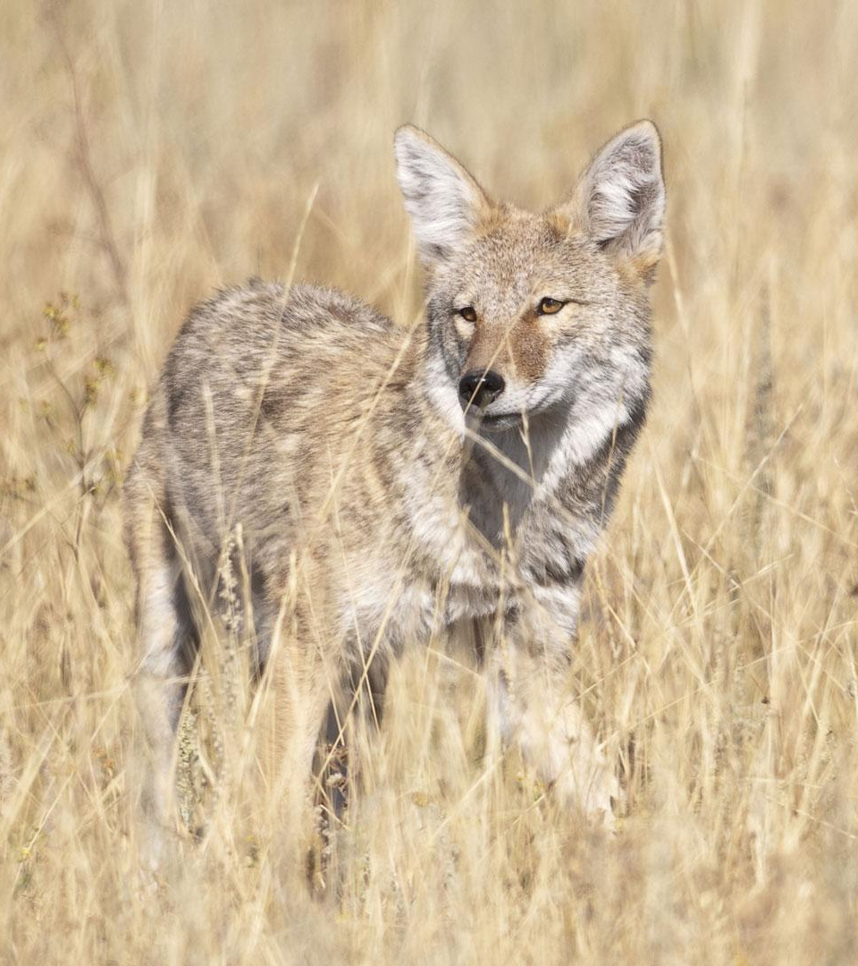
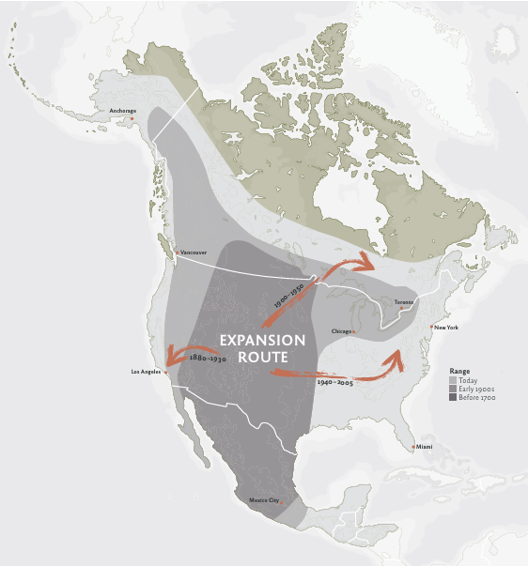
Coyote
(Canis Latrans)

Slide 8
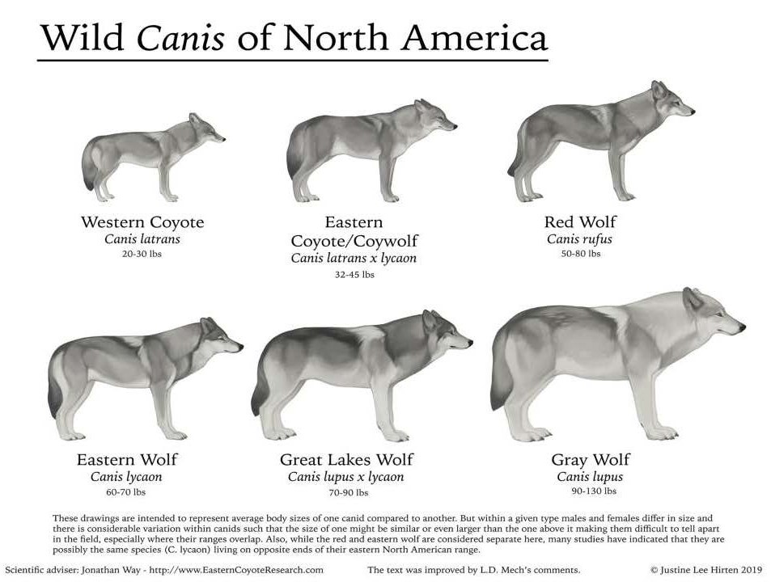
Credit: PBS

Slide 9
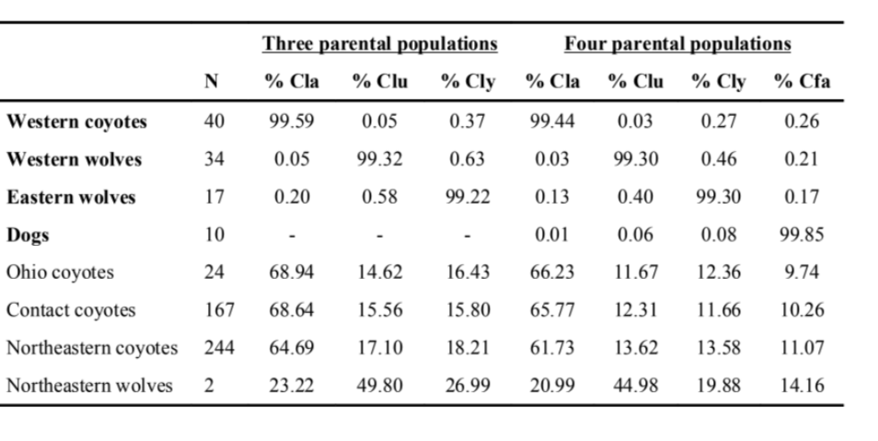
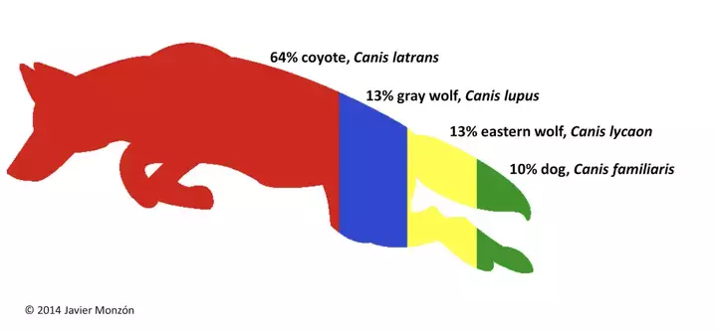
Our Resident Canid: Eastern Coyote

Slide 10
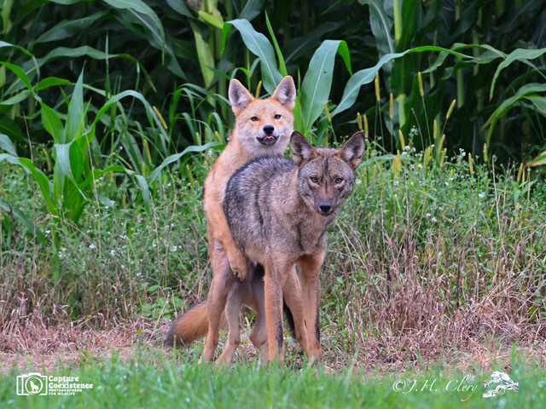
Canis soupus?

Slide 11
Policy Frameworks:
Wolves v. Coyotes
Wolves
Full protection:
Federally protected pursuant to the Endangered Species Act
No “take” (ESA Sec. 9) prohibited to harass, hunt, shoot, capture, trap, kill, collect, wound, harm, or pursue
Coyotes
Unprotected:
In Vermont, New Hampshire, Maine there is Year round season, no bag limits. Night hunting allowed during limited times.
In New York, season from Oct 1 - Mar 31, no bag limit. Night hunting allowed.

Slide 12
Canis soupus?

Slide 13
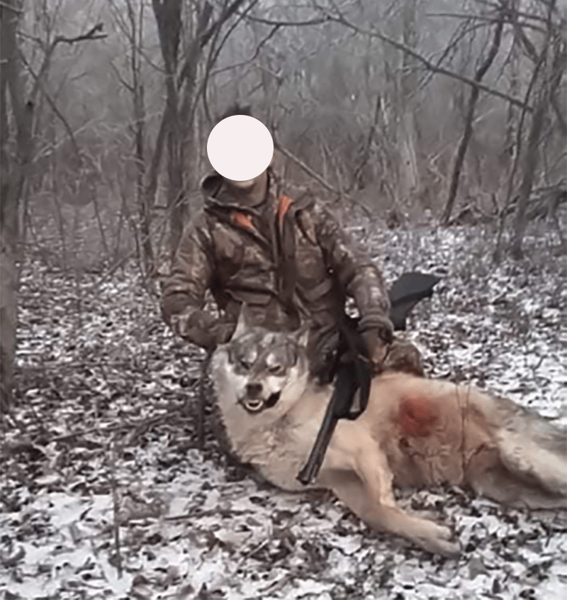
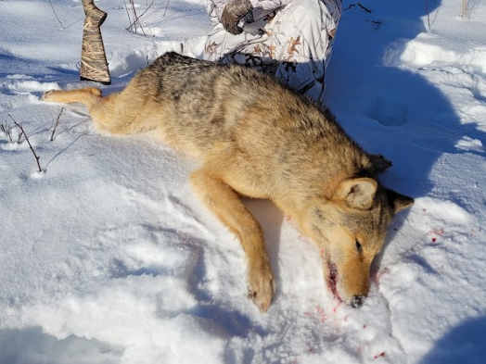
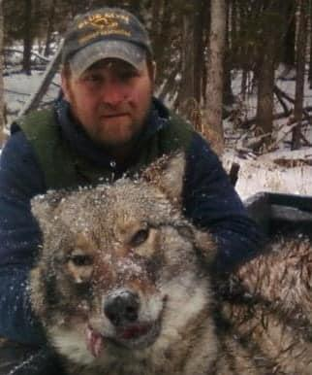
A Case of Mistaken Identity?

Slide 14
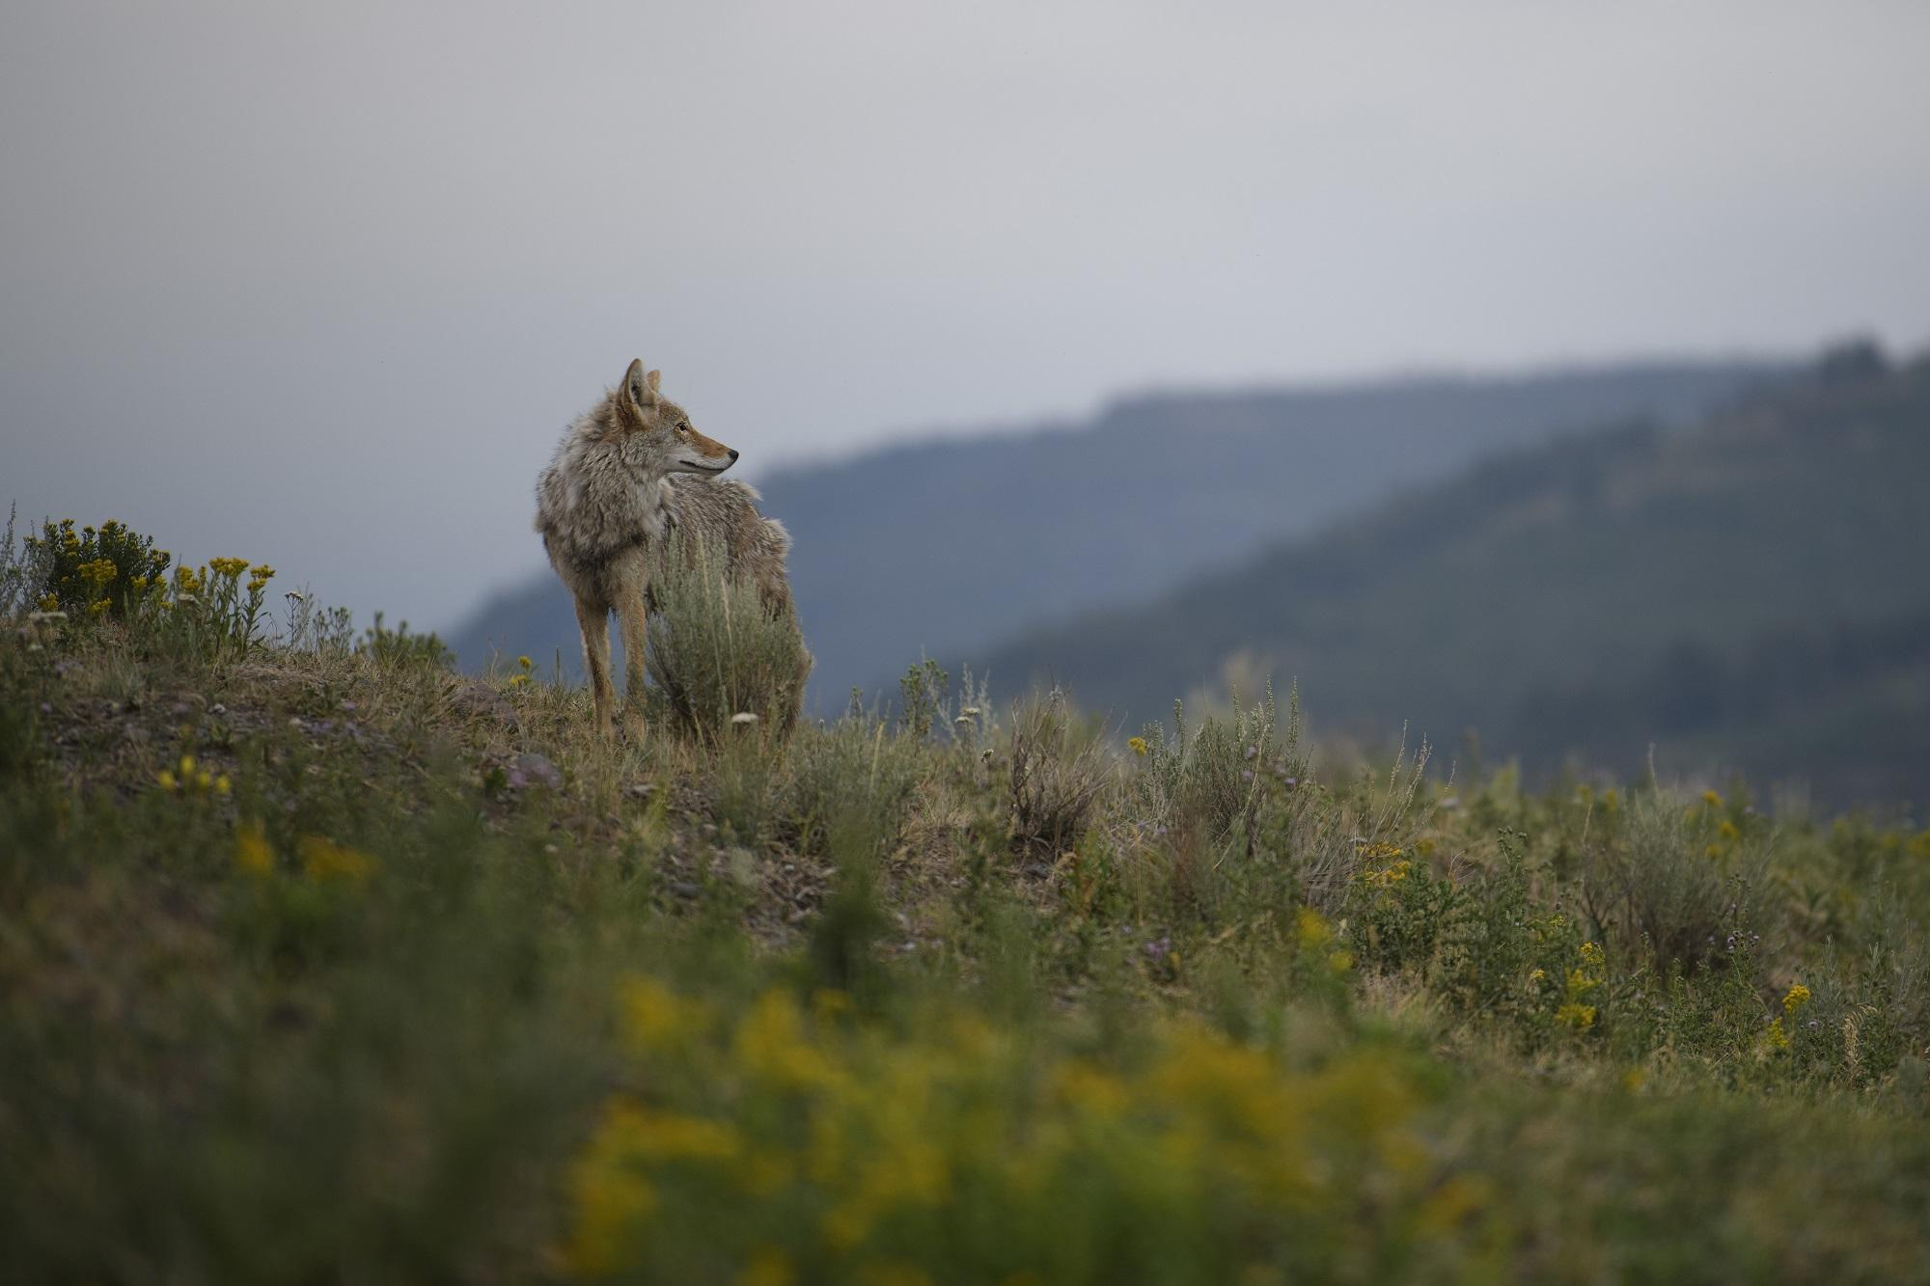
“The ability of coyote hunters in the northeast to effectively discern wolves from coyotes in the field may also influence the likelihood of natural wolf recolonization.” - Vermont State Wildlife Action Plan 2015 (Species Assessment Canis lupus)

Slide 15
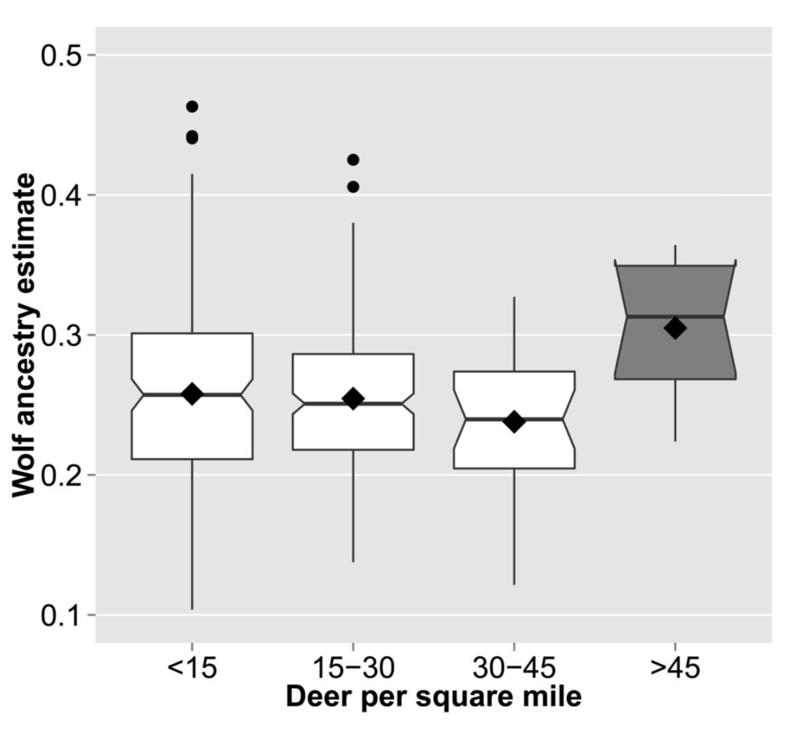
Ecological Role of Eastern Coyotes
Canids in packs dominated by eastern coyote ancestry consumed significantly less ungulate biomass and more anthropogenic food than packs dominated by wolf ancestry. Benson et al. 2017.
Coyotes living in areas of high deer density are more wolf-like genetically. Monzón et al. 2015.

Slide 16
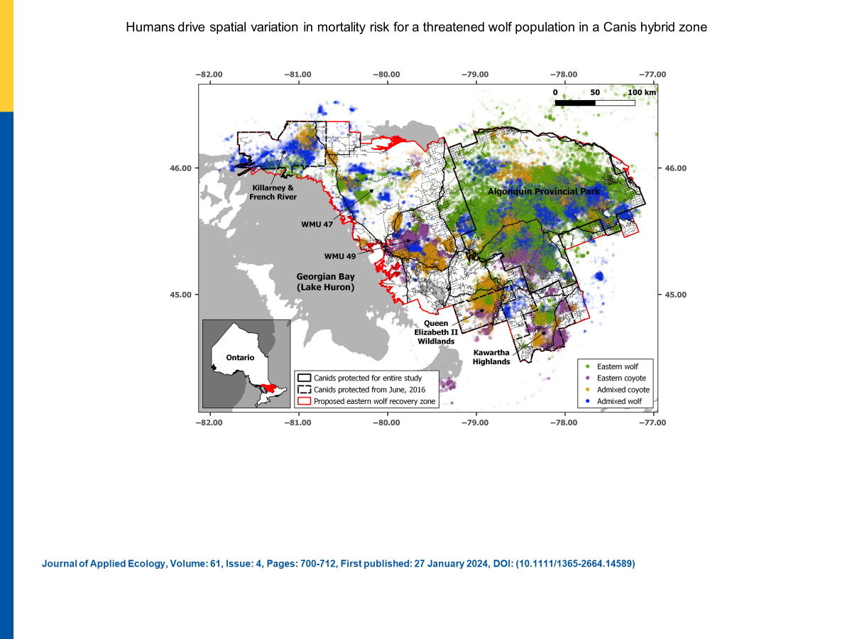
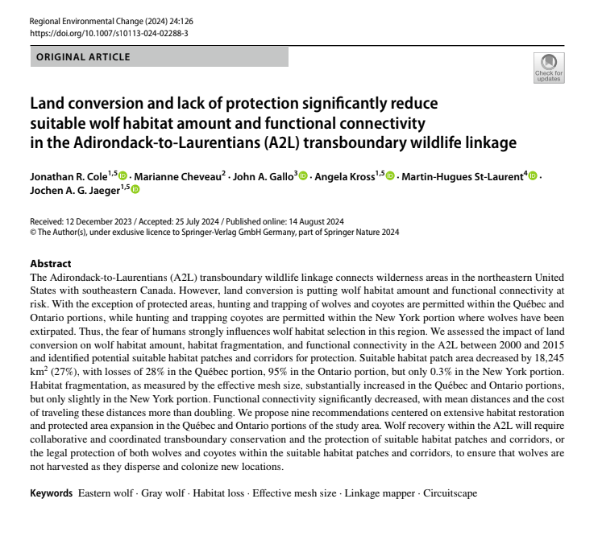
Eastern Wolves

Slide 17
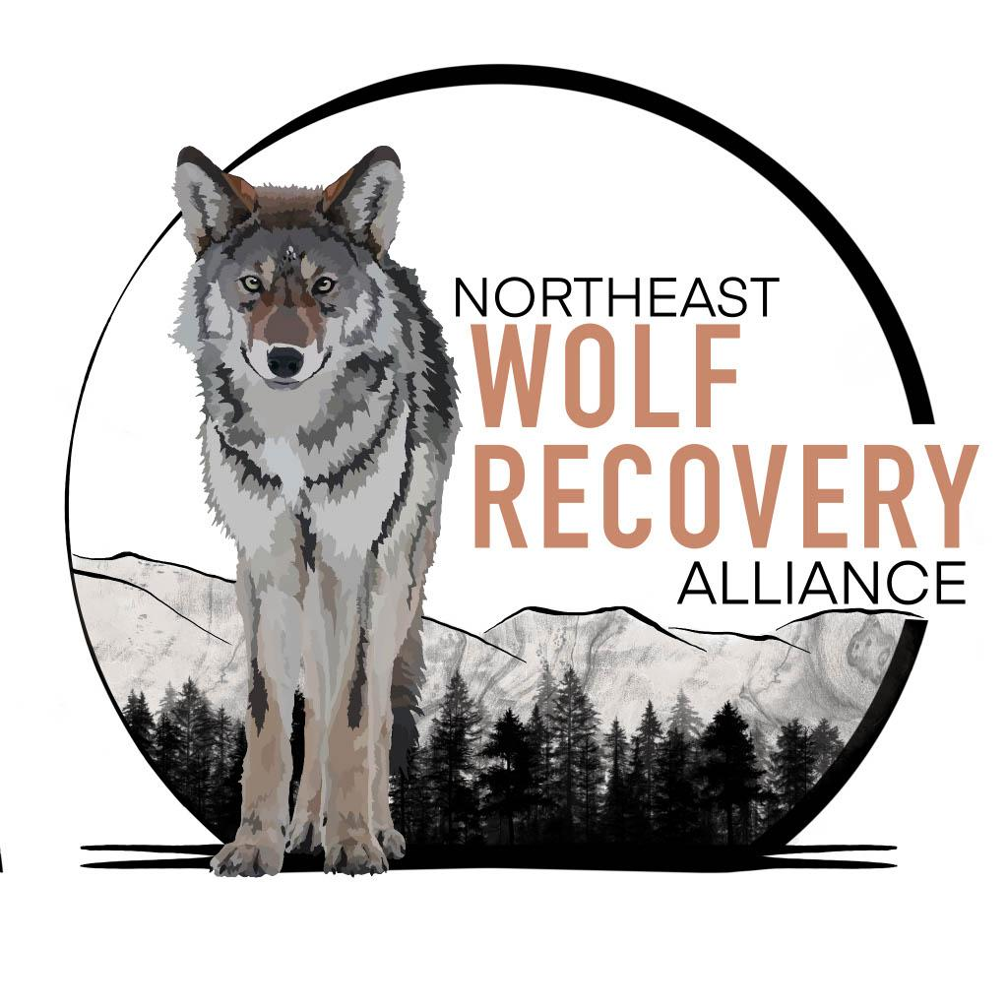
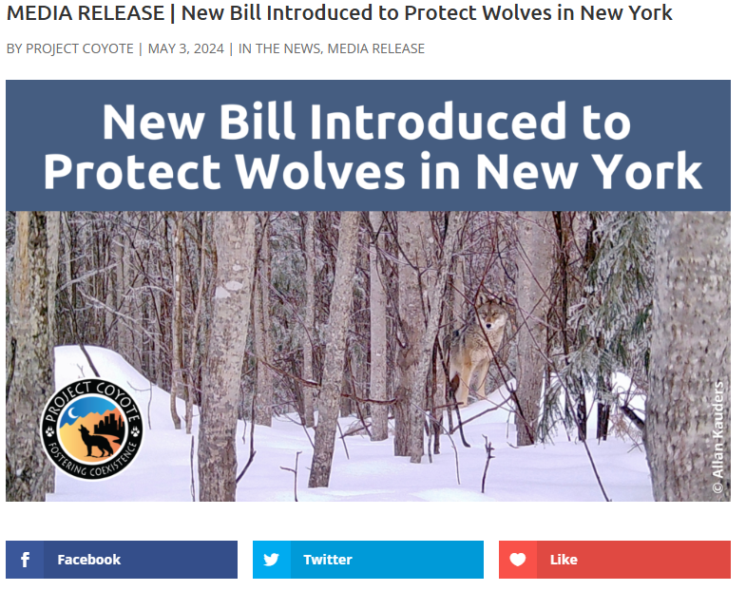
How do we help wolves rewild the Northeast?
Protect all wild canis
Keep wolves on the federal ESA
More research and DNA analysis of wild canis in the Northeast
Increase social tolerance and public perceptions of wild canids

Slide 18
Thank you!

