Slide 1
SierraClub
Protect America’s Environment.
For our Families…For our Future
85 Second Street – San Francisco, California 94105

Slide 2
SAFE DRINKING WATER IS ESSENTIAL FOR HEALTHY COMMUNITIES
Notes:
Source: Sierra Club

Slide 3
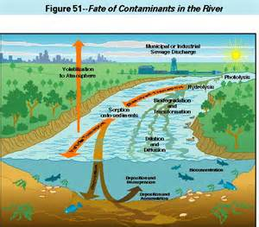
WATER POLLUTION IS A SERIOUS NATIONAL PROBLEM
EPA estimates that more than one-half of our rivers and streams and almost 70 percent of lakes, reservoirs, and ponds that have been assessed qualify as “impaired” or “threatened” due to pollution.
http://ofmpub.epa.gov/waters10/attains_nation_cy.control
Notes:
Source: EPA

Slide 4
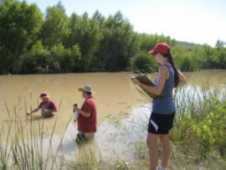
SIERRA CLUB WATER SENTINELS MONITOR OUR WATERS FOR POLLUTION
Notes:
Source: Arizona Water Sentinels

Slide 5
HOW DO SIERRA CLUB WATER SENTINELS DO THEIR WORK?
Standing knee-deep in the local waters they love Sierra Club Water Sentinels defend our waters by empowering committed local activists with accurate information and training in water-quality monitoring techniques and grassroots advocacy. This is a powerful position from which to advocate for the strongest protections and proactive changes.
You can learn more about this and get involved on our Grassroots Network site:
https://content.sierraclub.org/grassrootsnetwork/teams/national-water-sentinels
Notes:
Source: Sierra Club

Slide 6
IT WORKS ON BOTH WATER QUALITY AND QUANTITY
Throughout its history Sierra Club volunteers have been protecting both water quality and quantity. Today they still are busy opposing construction of dams, fracking for natural gas, drilling for oil, unsafe pipelines and mountaintop removal, a big polluter of local streams.
Notes:
Source:EPA

Slide 7
WATER POLLUTION IS WIDESPREAD IN THE UNITED STATES
Notes:
Source: Rita Chapman

Slide 8
WHAT IS CAUSING ALL THIS POLLUTION?
Notes:
Source: US EPA

Slide 9
UNESCO defines emerging pollutants as any synthetic or naturally-occurring chemical or micro-organism that is not commonly monitored or regulated, and is thought to have harmful impacts on human health and the environment, possibly including pharmaceuticals, personal care products, pesticides, industrial and household chemicals, metals, surfactants, industrial additives and solvents. Their potential impacts could include chronic toxicity, endocrine disruption in humans and aquatic wildlife, and development of bacterial pathogen resistance.
Case studies of emerging pollutant impacts range from: pharmaceutical pollution in Nigeria and the Baltic Sea region; persistent inorganic and organic pollutants (POPs) in the hydrological system of the Keoladeo National Park in India; organochlorine pesticides in Yucatán, Mexico; to contaminants in irrigation water in the Oued Souhil area, Nabeul, Tunisia.
Read more: http://chemicals-l.iisd.org/news/unesco-launches-project-on-emerging-pollutants-in-wastewater/
Notes:
Source UNESCO – United Nations Educational, Scientific and Cultural Organization

Slide 10
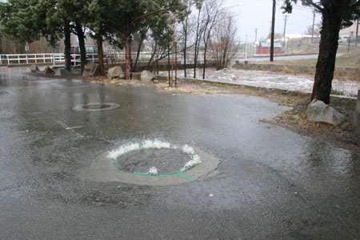
SEWER HEADS CAN OVERFLOW DURING STORMS, POLLUTING NEARBY CREEKS
Notes:
Source: Doris Cellarius

Slide 11
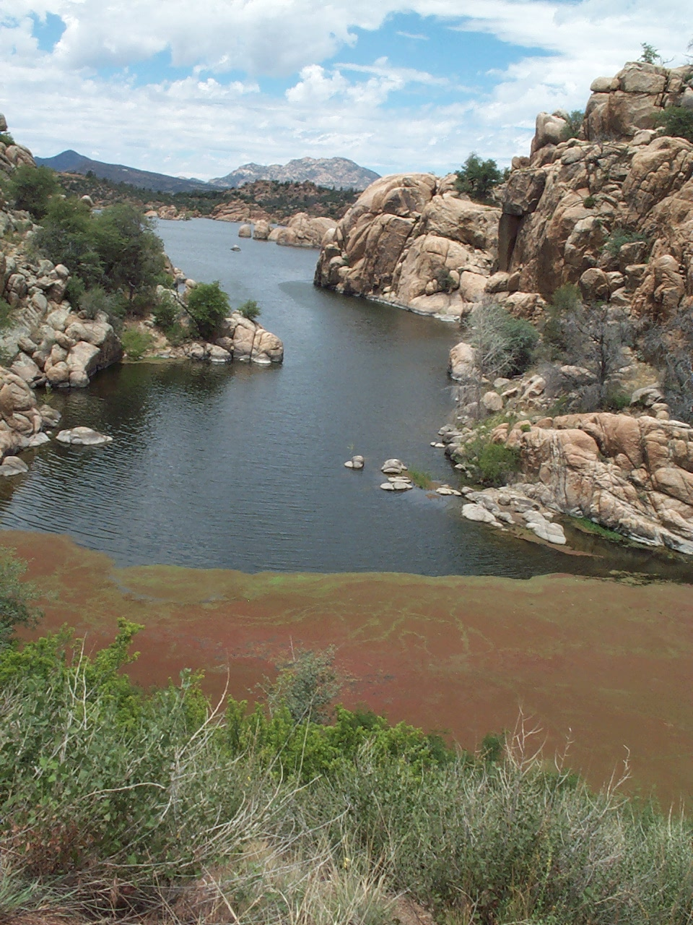
FERTILIZER AND ANIMAL WASTE CAN CAUSE ALGAE BLOOMS, SOME TOXIC
Notes:
Source: Doris Cellarius

Slide 12
FIRE RETARDANTS FOUND IN HOMES CAN CONTAMINATE AIR AND CLOTHES
Notes:
Source: Green Science Policy Institute

Slide 13
THIS CONTAMINATION IS WASHED DOWN THE DRAIN INTO OUR WATERS
Notes:
Source: Washington Toxics Coalition

Slide 14
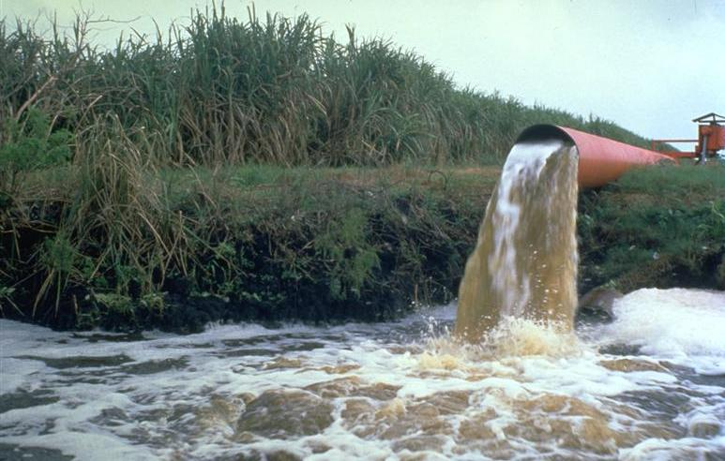
WASTEWATER FROM AGRICULTURE IS OFTEN POORLY CONTROLLED
Notes:
Source: Florida Sierra Club

Slide 15
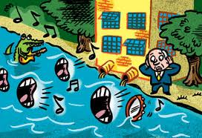
WASTEWATER FROM SOME INDUSTRIES MAY BE POORLY REGULATED
Notes:
Source: Sierra Club

Slide 16
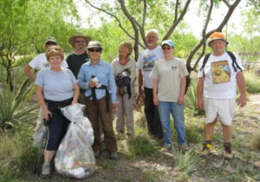
AS WATER SENTINELS PICK UP TRASH THEY IDENTIFY POTENTIAL POLLUTION
Notes:
Source: Arizona Water Sentinels

Slide 17
VOLUNTEERS SOON BECOME INVOLVED IN MORE THAN JUST PICKING UP TRASH
Sierra Club trains volunteers to identify what pollution issues are most serious and need to be reported to those who might fix them.
Notes:
Source: Valley of the Fox Water Sentinels

Slide 18
Notes:
Source: Ohio Water Sentinels

Slide 19
Notes:
Source: Ohio Water Sentinels

Slide 20
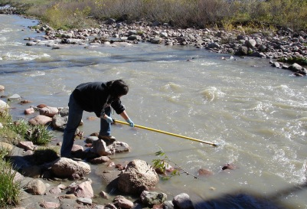
TRAINING INCLUDES HOW TO COLLECT SAMPLES SAFELY
Notes:
Source: Fountain Creek (Colorado) Water Sentinels

Slide 21
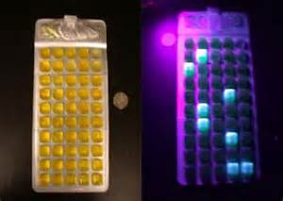
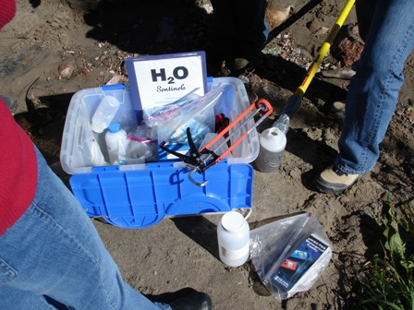
SAMPLES CAN BE SENT TO EPA LABS OR TESTED BY THE CITIZENS
Z
Optical brighteners are added to laundry detergents to make clothes look “whiter”. They adhere to cotton and fluoresce when viewed under ultraviolet light. Testing for them in water is a simple, low-cost way to screen for the presence of domestic sewage and determine whether bacteria found there is from people or animals. Testing involves placing clean cotton pads in secure “baskets” in water long enough for them to absorb traces of optical brighteners.
Notes:
Source:EPA

Slide 22
E-COLI CAN BE MEASURED WITH ULTRAVIOLET LIGHT
Z
Some citizen groups use the EPA approved Colilert system to count how many bacteria are in a water sample. Samples are poured into special trays and incubated overnight, When observed under UV light, glowing capsules indicate the number of E-coli colony forming units per 100 ml. of the sample.
Optical brightener testing can then be used to determine whether the bacteria are from humans or animals.
Notes:
Source: Colilert

Slide 23
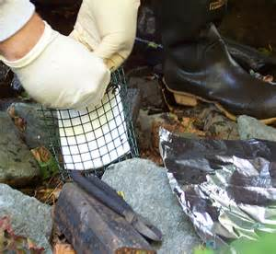
OPTICAL BRIGHTENERS CAN IDENTIFY POLLUTION FROM HOUSEHOLD SEWAGE
Z
Optical brighteners are added to laundry detergents to make clothes look “whiter”. They adhere to cotton and fluoresce when viewed under ultraviolet light. Testing for them in water is a simple, low-cost way to screen for the presence of domestic sewage and determine whether bacteria found there is from people or animals. Testing involves placing clean cotton pads in secure “baskets” in water long enough for them to absorb traces of optical brighteners.
Notes:
Source: EPA

Slide 24
WHAT CAN CITIZENS DO TO HELP STOP OR PREVENT WATERE POLLUTION?
Educate the public by sharing information at community fairs and public meetings
Notes:
Source: Sierra Club

Slide 25
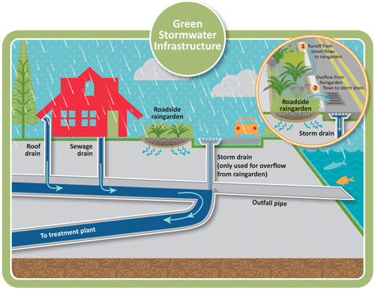
THERE ARE MANY WAYS TO REDUCE AND PREVENT POLLUTION OF OUR WATERS
Notes:
Source: US EPA

Slide 26
DEVELOP HELPFUL GUIDANCE DOCUMENTS FOR CITIZENS
Community groups often develop guidance specific to their own communities. Each has its own climatic considerations, local regulations, information about who to contact, and how to report pollution.
Notes:
Source: Prescott Creeks, Arizona

Slide 27
P
PICK UP PET WASTE
Pet wastes are flushed out by rainstorms into our creeks. They contain bacteria and nutrients that contribute to water pollution.
Notes:
Source: US EPA

Slide 28
MOST PEOPLE DO NOT REALIZE THAT MANY CHEMICALS ARE NOT TESTED OR REGULATED
Notes:
Source: Sierra Club Toxics Committee

Slide 29
TAKE ACTION. PICTURES AND DATA CAN BE USED TO ADVOCATE FOR STRONGER LAWS AND PROGRAMS
Notes:
Source: Yavapai Group, Sierra Club

