Slide 1
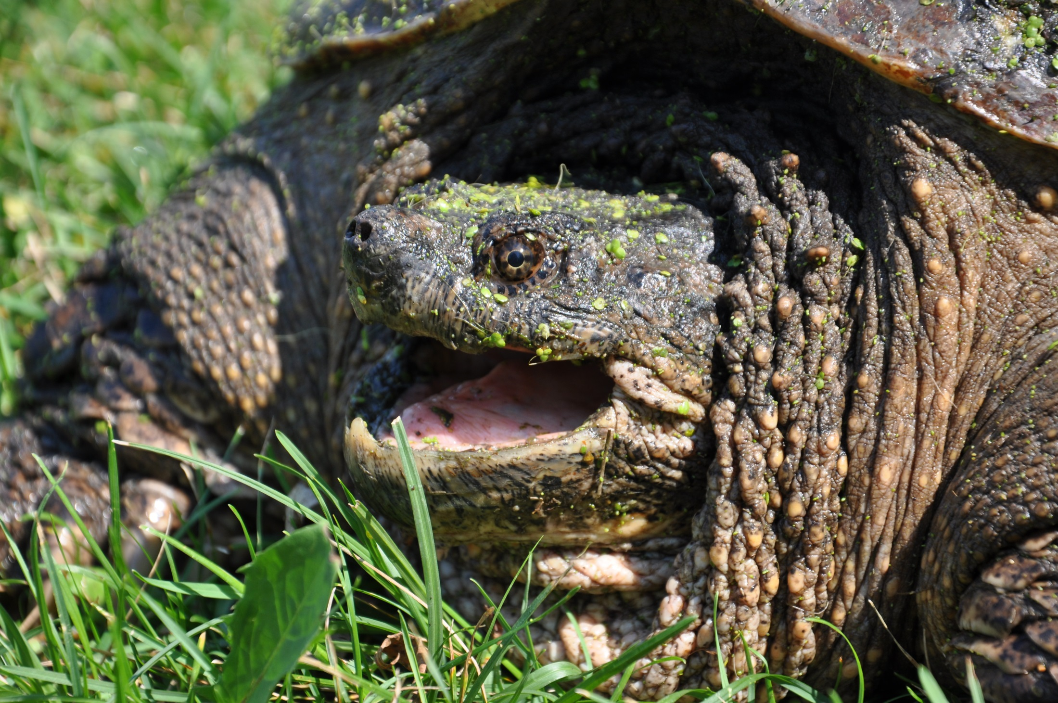

Challenges Facing Iowa’s Turtle Populations
Chad R. Dolan
Iowa DNR Southeast Regional Office
110 Lake Darling Road
Brighton, IA 52540

Slide 2
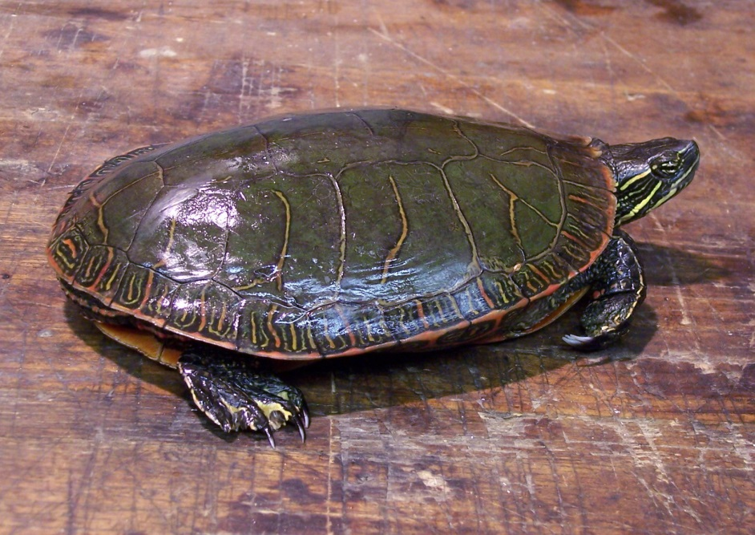
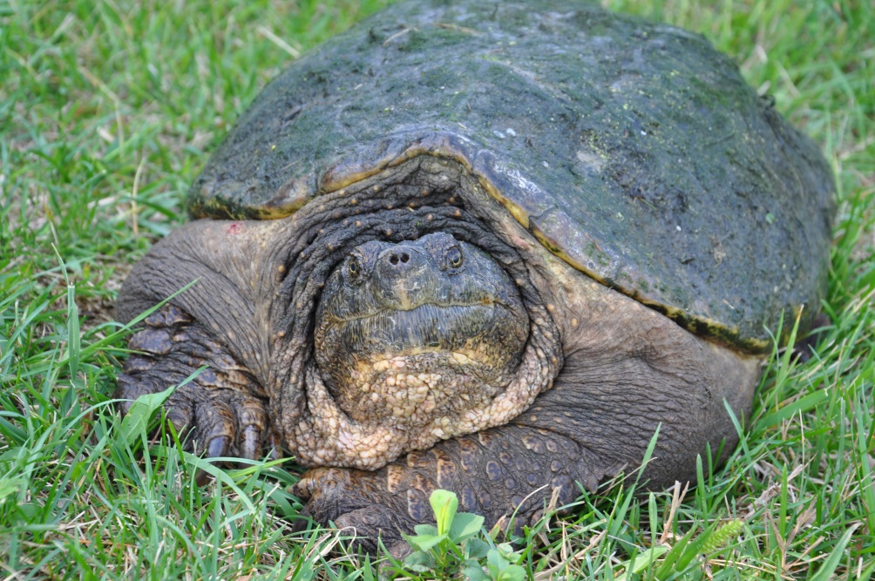
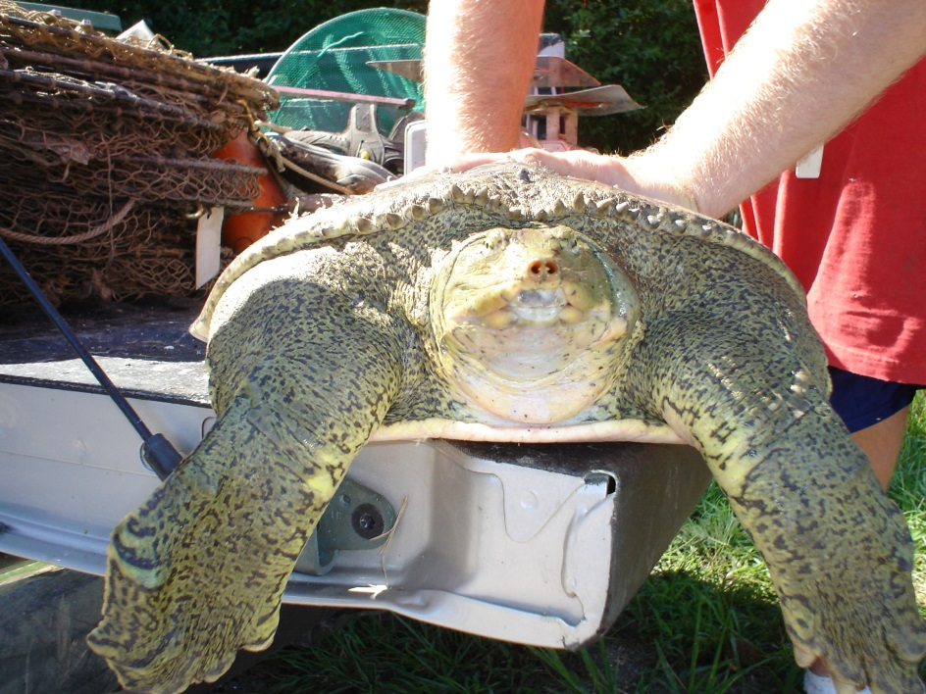
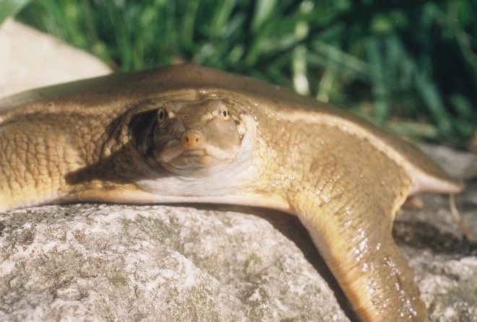
Iowa’s Harvestable Turtle Species
Food

Slide 3
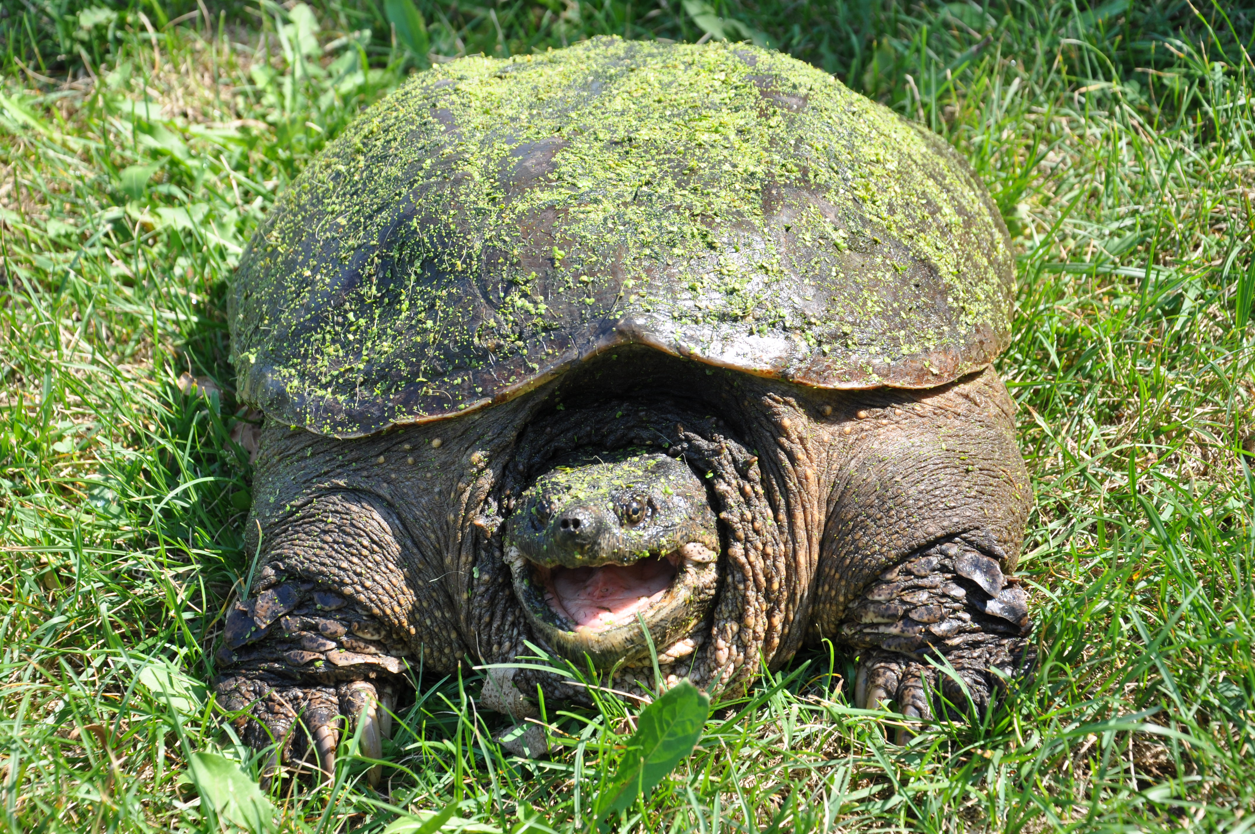
Why are turtles in decline?
Habitat Loss & Degradation
Exotic/Invasive Species
Environmental Pollution
Disease
Global Climate Change
Unsustainable Use Without Proper Management
(Ernst & Lovich 2009)

Slide 4
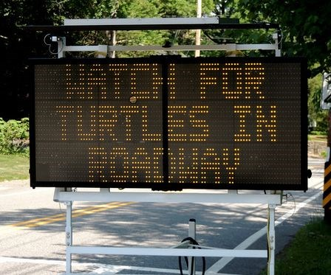
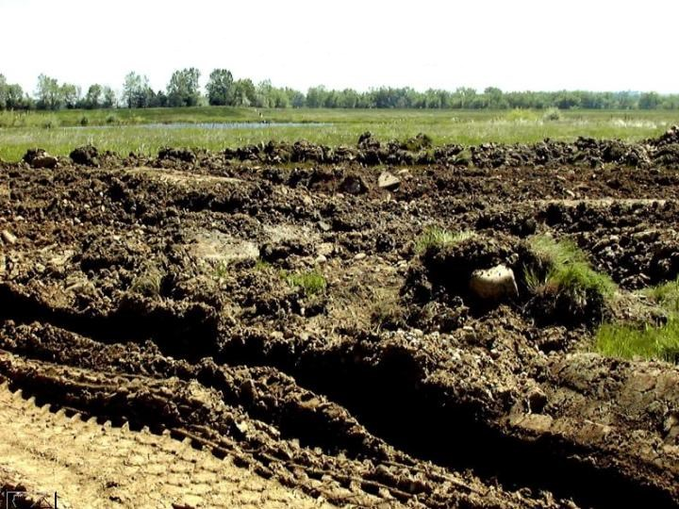
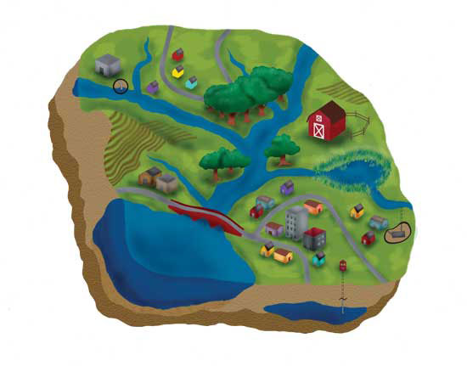
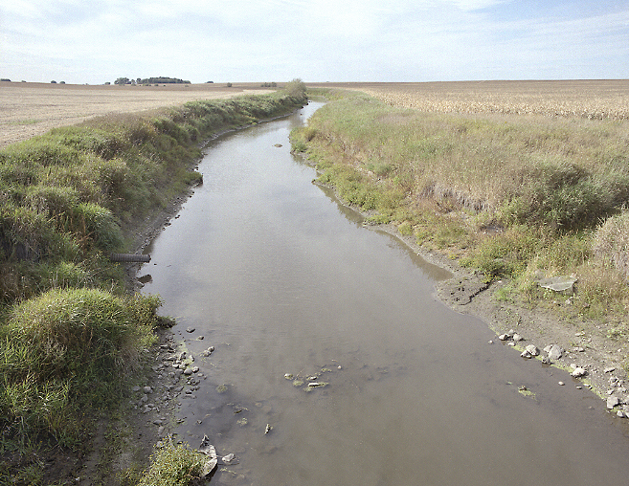
1. Habitat Loss & Degradation
Road fragmentation
Wetland destruction
Noted w/ regards to Turtles in Iowa by Vandewalle & Christiansen (1996)
Water Quality Degradation
Damage to River Systems

Slide 5
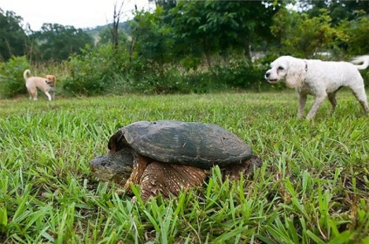
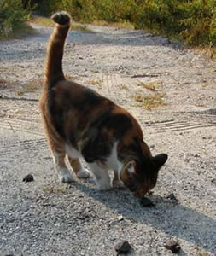
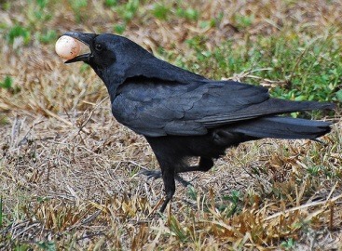
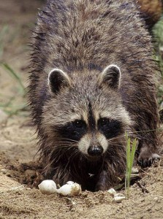
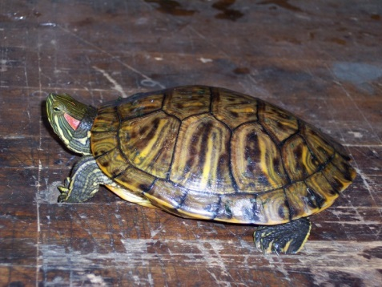
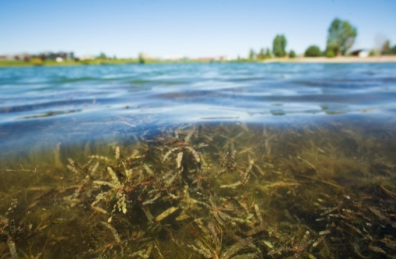
2. Exotic/Invasive Species
2,300 exotic species have been established in the U.S., nearly 7.7 species per decade
Habitats change & plant community organization is modified
Delicate relations between plants & animals are altered or eliminated
Invasive doesn’t always mean exotic
Numerous native turtle nest and hatchling predators flourish in human-altered landscapes

Slide 6
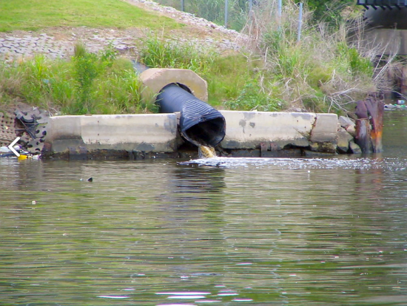
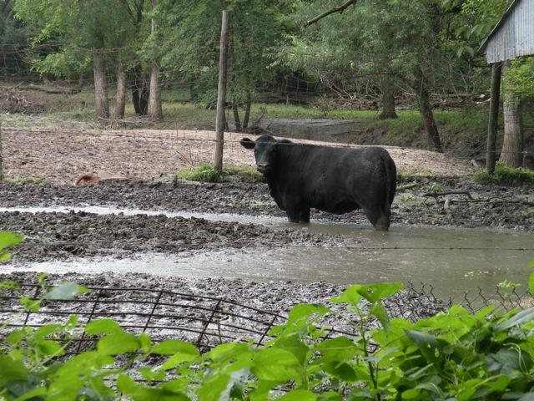
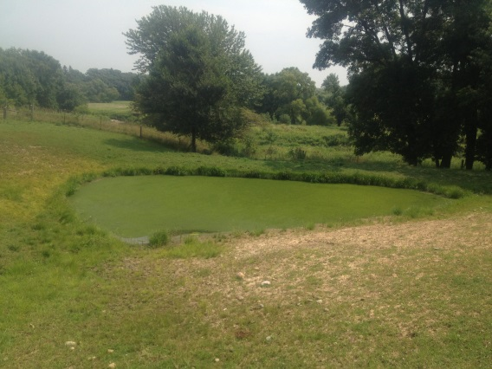
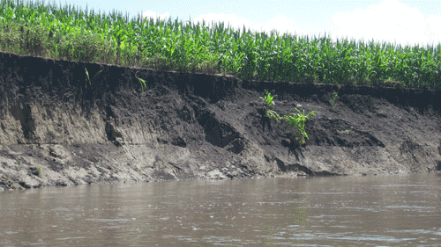
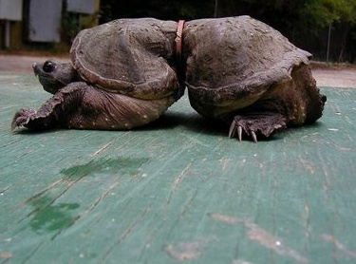
3. Environmental Pollution
Turtles:
Can accumulate arsenic, mercury, other heavy metals, organochlorines, radionucleotides, and crude oil
Can be poisoned by pesticides or via consuming non-food items that mimic prey
      Death
      Sterility
      Sex ratio effects

Slide 7
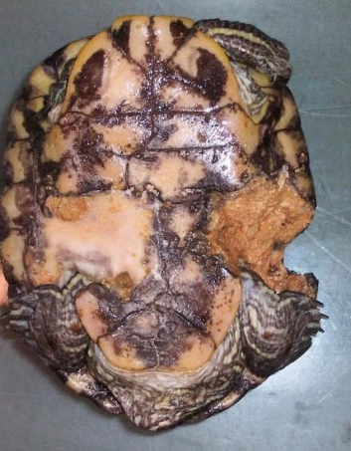
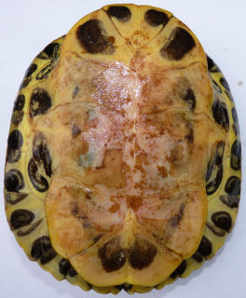
4. Disease
Can cause shell lesions; degree of necrosis can be shocking
Causes are not well understood
Disease outbreaks can reduce survival
Potentially severe effects on turtle populations
Been known to affect red-eared slider, painted turtle, common snapping turtle, & stinkpot

Slide 8
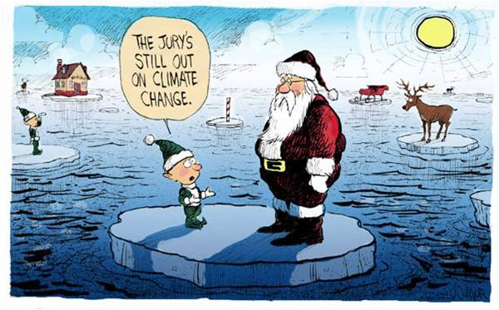
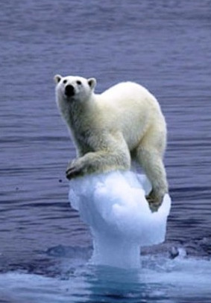
5. Global Climate Change
Recently, some scientists have suggested that global climate change has the potential to eliminate the production of male offspring if average global temps increase 4º C (2.2º F) and that increases of less than 2º C (1.1º F) may dramatically skew sex ratios (Janzen 1994)
Also, because turtles are ectothermic (cold-blooded), their digestion rate, growth, reproduction, and activity are all closely related to temperature
Changing water levels in river, lakes, and wetlands may impact nesting sites and habitat

Slide 9
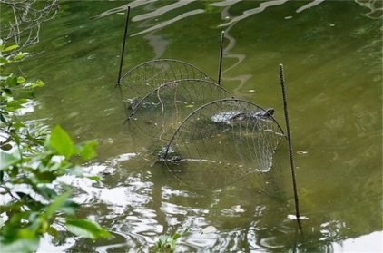
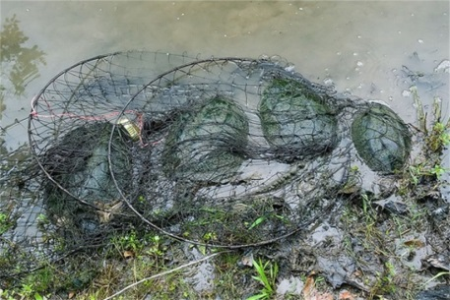
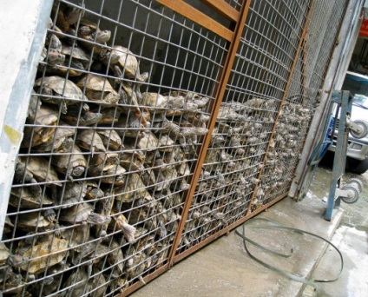
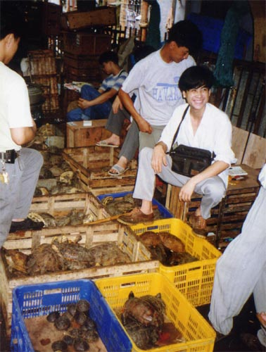
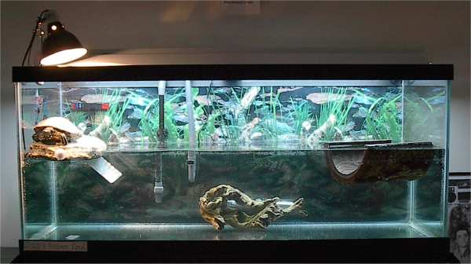
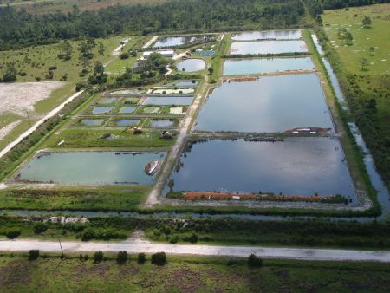
6. Unsustainable Use Without Proper Management
Sport Harvest - collection of small to intermediate size turtles for pets or larger turtles for food (domestic use)
Commercial Harvest – collections to supply the pet or food trade (domestic and international markets – particularly Asia; Mali et al. 2014) and broodstock for aquaculture units
In combination – harvest has resulted in the removal of many adults from populations
Gathering of eggs and juveniles - for
commercial or domestic use reduces
the rate of replacement of those adults
left to die in the wild
Many scientists believe - that given slow rates of maturation and reproduction, turtles cannot withstand exploitation and still maintain their numbers

Slide 10
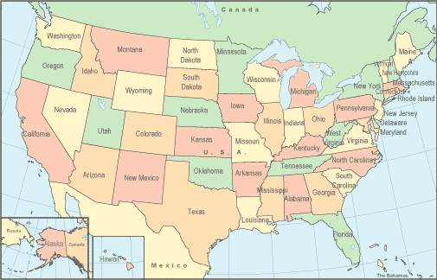
X No commercial turtle harvest
X Limited waters
X Season, size limits, other rules
X- Ontario
X
X
X
X
X
X
X
X
IOWA
X
X
X
X
X
X
X

Slide 11
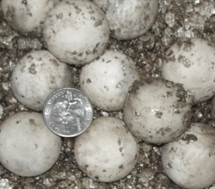
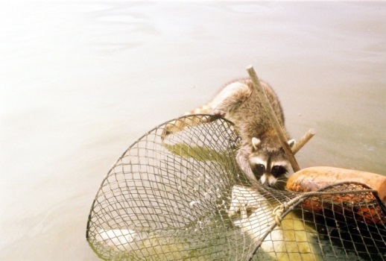

Life History Characteristics
Iowa’s Harvestable Species
Longevity (Ersnt & Lovich 2009)
    20-60 years (varies by spp.)
Age at Maturity (Ersnt & Lovich 2009; LeClere 2013)
    4-5 years for males, 7-10 years for females
Clutch Sizes (Ersnt & Lovich 2009; LeClere 2013)
    9-35 eggs /clutch , 1-2 clutches per year (varies by spp.)
Annual Predation Rates (Ernst & Lovich 2009)
    55%-100% in some years (varies by spp.)
    Recently laid nests more susceptible than older ones
    Rainfall or use of preferred nesting areas can
    reduce predation
    Can result in low recruitment
Exploitation Rates (Zimmer-Shaffer et al. 2014)
    Snappers: ≤2.3% to maintain a stationary
    population
    Softshells: no harvest can be sustained

Slide 12
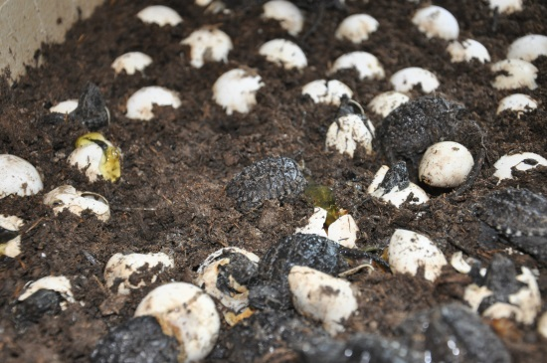
308 Bobcats
43 Whitetails
1 Snapper
35 eggs

Slide 13
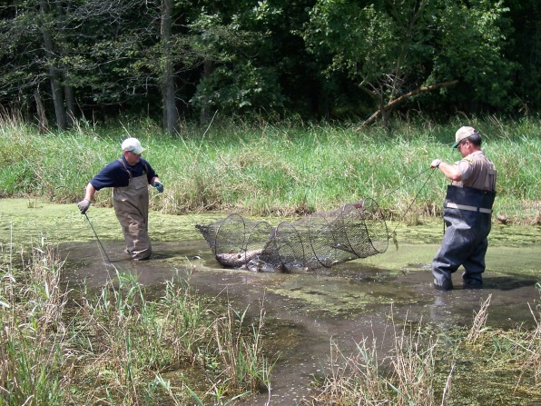
Iowa Commercial Turtle Harvesters by Year
Maximum = 179 in 2012
Number
Year

Slide 14
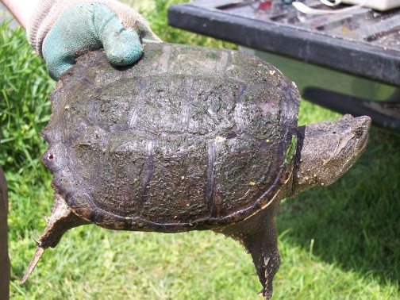
Snapper Total Annual Harvest
Maximum = 203,156 lbs. in 2007
Harvest (lbs.)
Most harvested turtle species since 1987 (3,210,400 lbs.)
Year

Slide 15
Snapper Average Harvest Per Licensee
Slight decrease of ~ 10 lbs. per harvester per year
Harvest (pounds)
Year

Slide 16
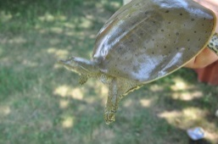
Softshell Total Annual Harvest
Maximum = 46,496 in 2002
Harvest (pounds)
Year

Slide 17
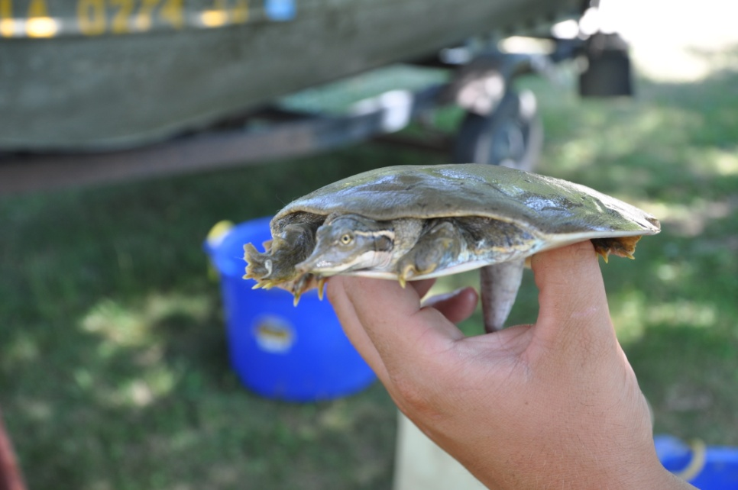
Softshell Average Harvest Per Licensee
Decreasing trend in last 14 years
Harvest (pounds)
Year

Slide 18
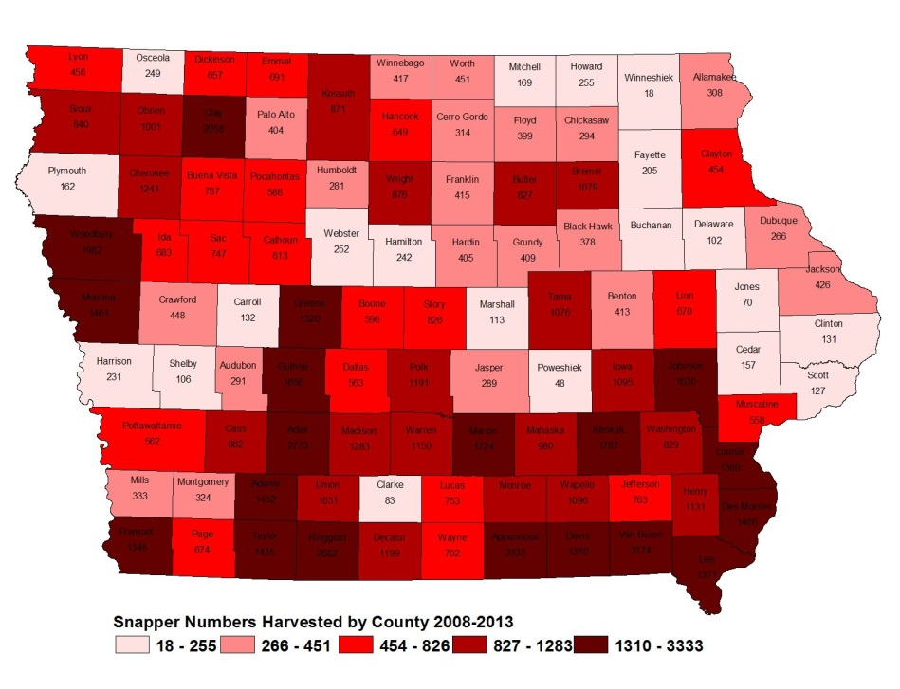
Common Snappers Harvested by County
2008-2013
2014
Historically, much of the turtle harvest has occurred in southeast Iowa. A slight shift to south-central Iowa was observed in 2014.

Slide 19
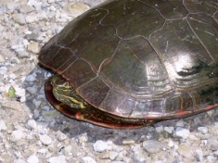

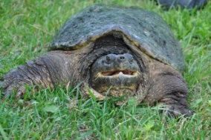
Turtle Catch in Southeast Iowa (2010-2014)
2%
1%
34%
35%
22%

Slide 20
Snapper Relative Frequency (2010-2014)
11.4 in.
13.0 lbs.
Relative frequency (%)
Female
Straight-line carapace length (inches)

Slide 21
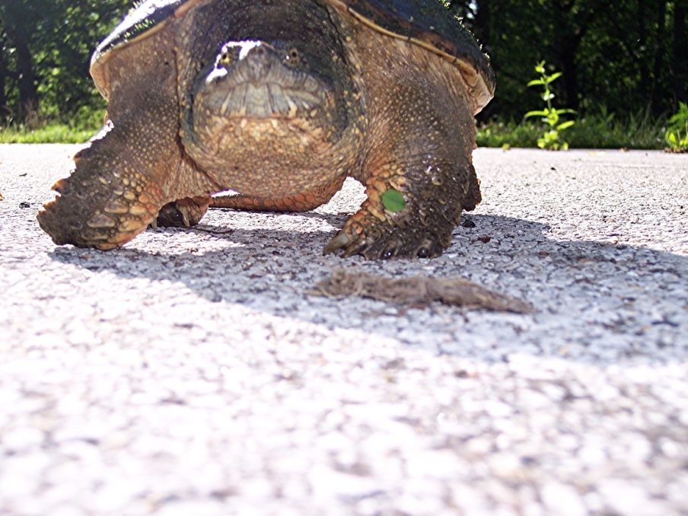
Can Iowa’s turtle populations sustain themselves, long-term, given the challenges they’re facing?

